Slide 1
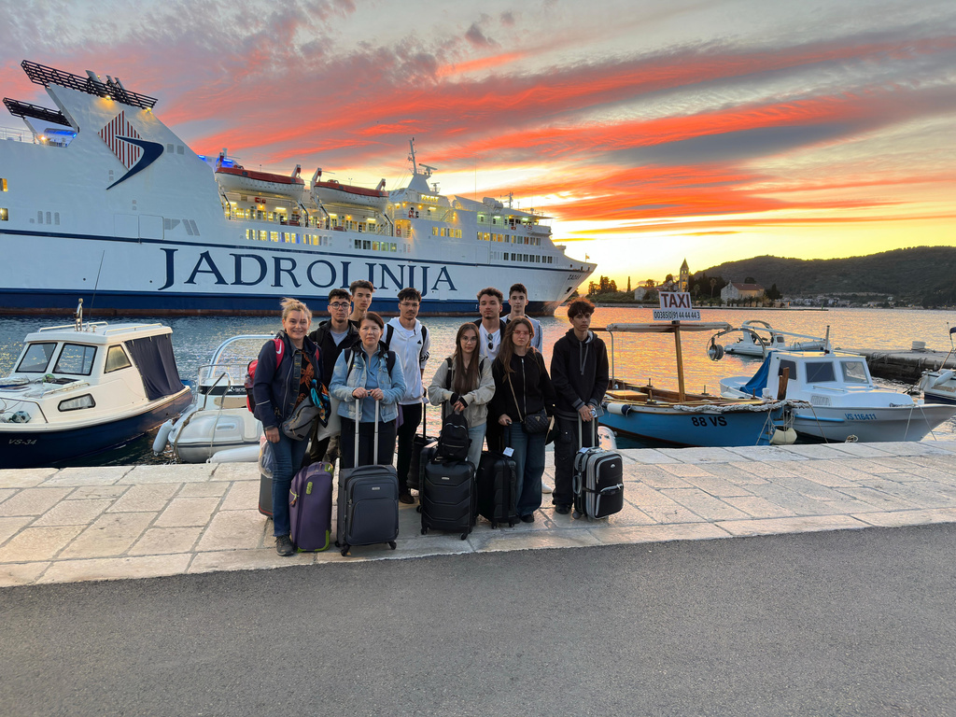
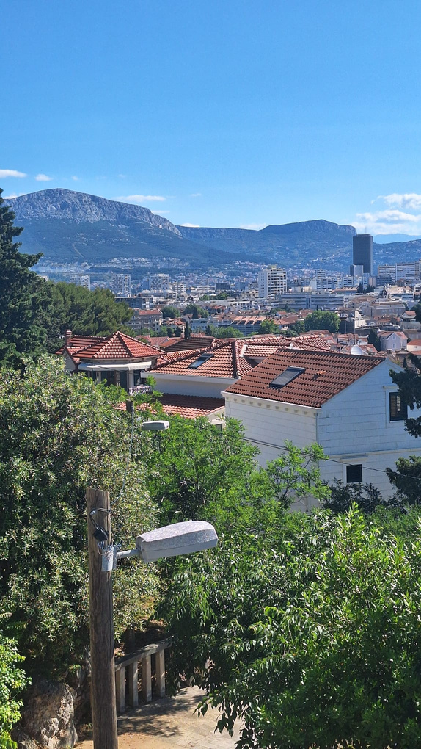
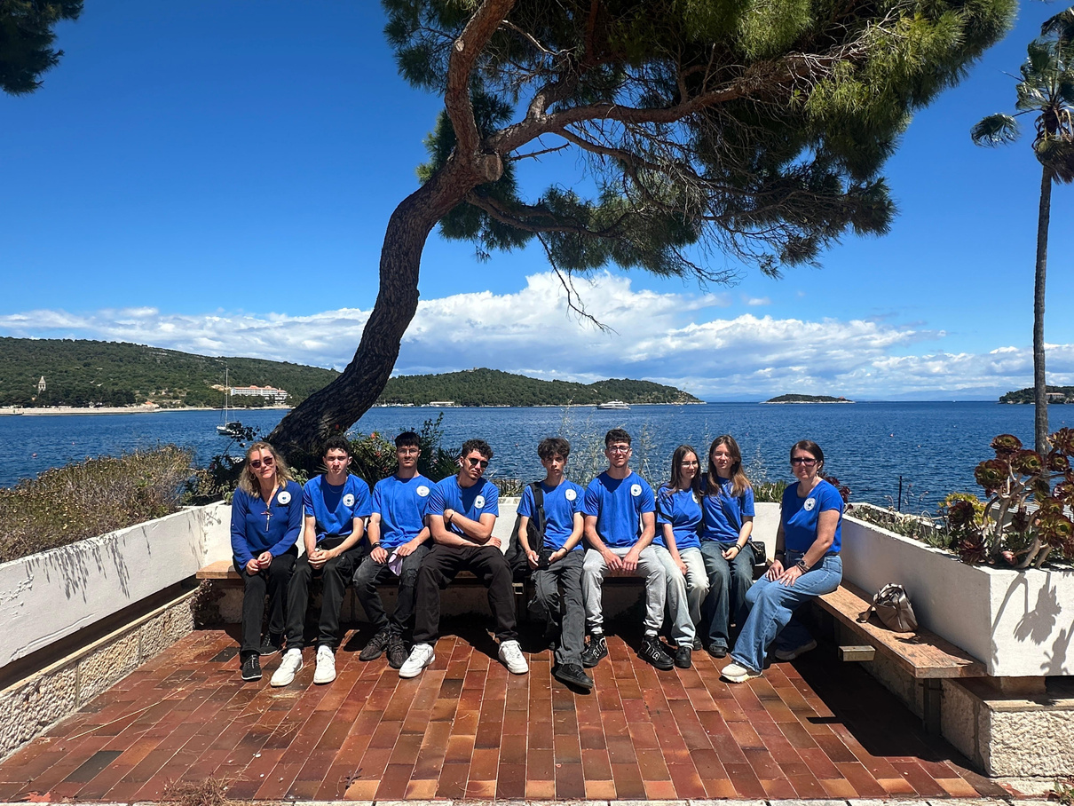

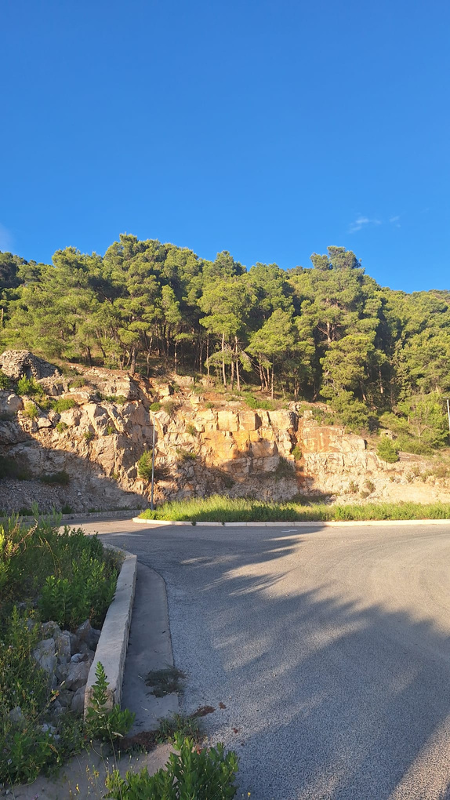
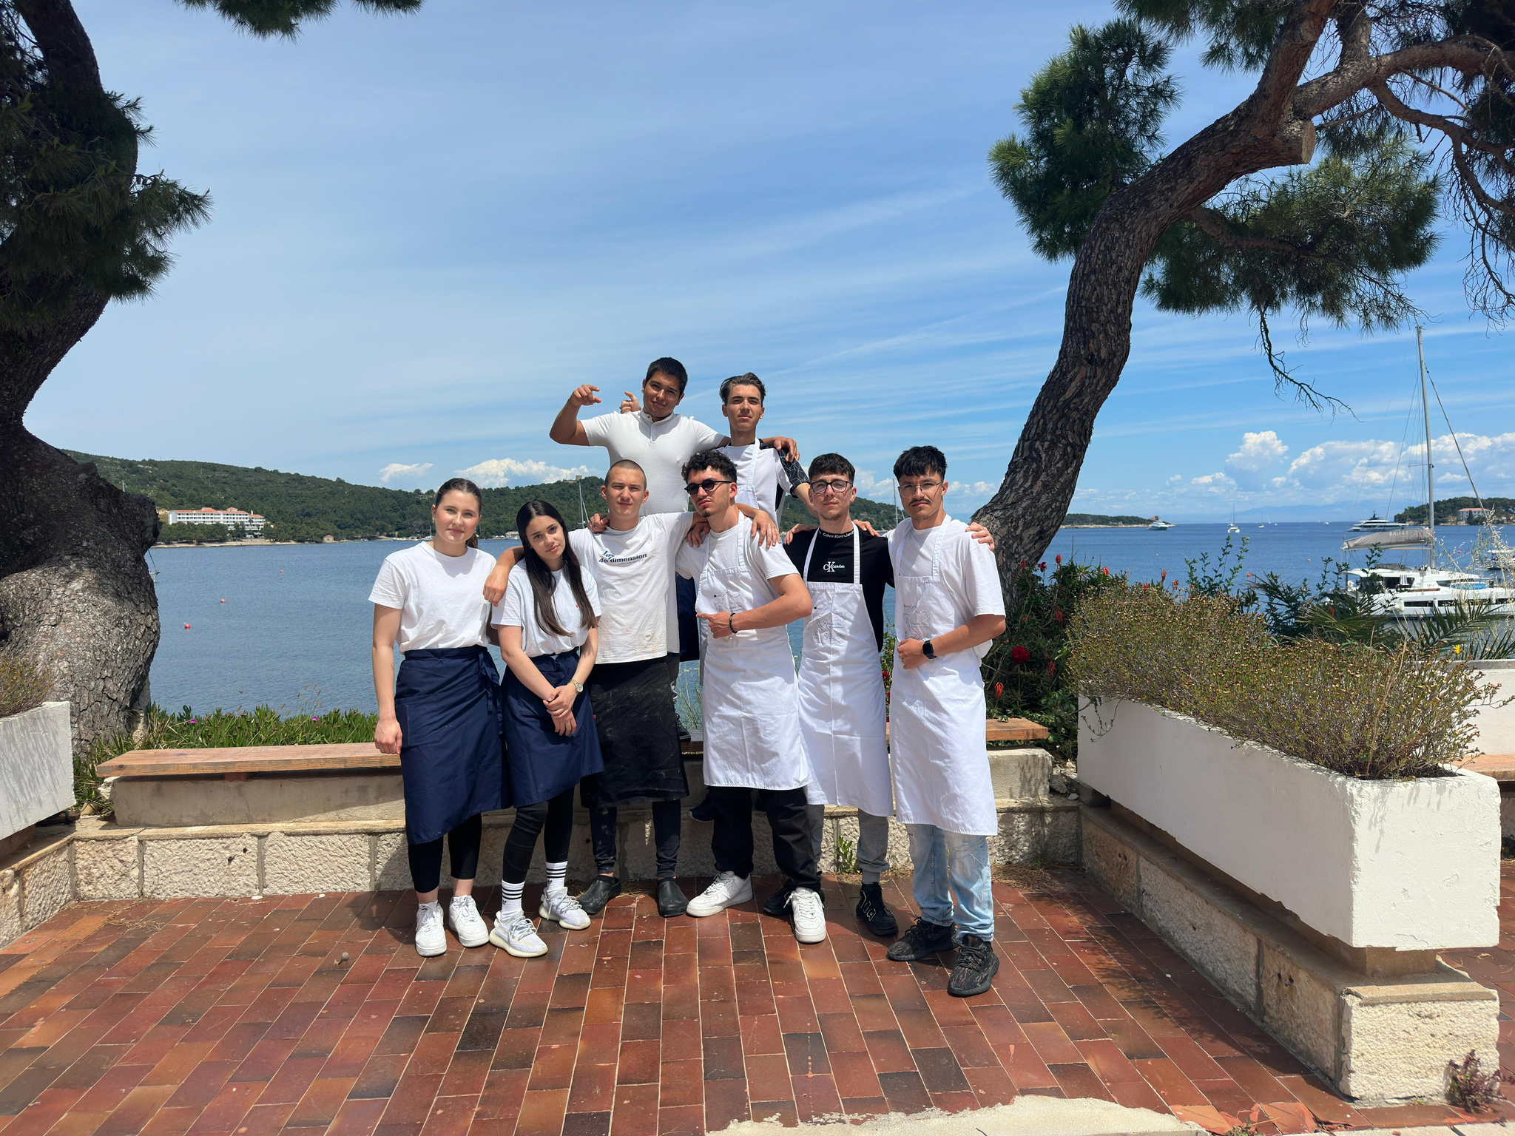
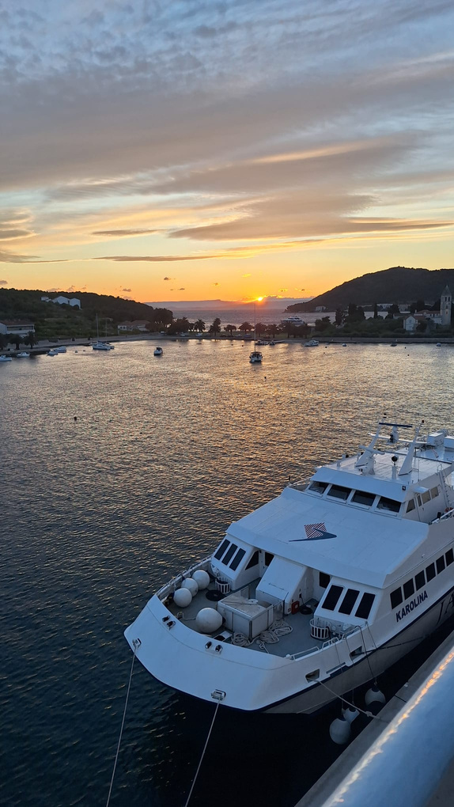
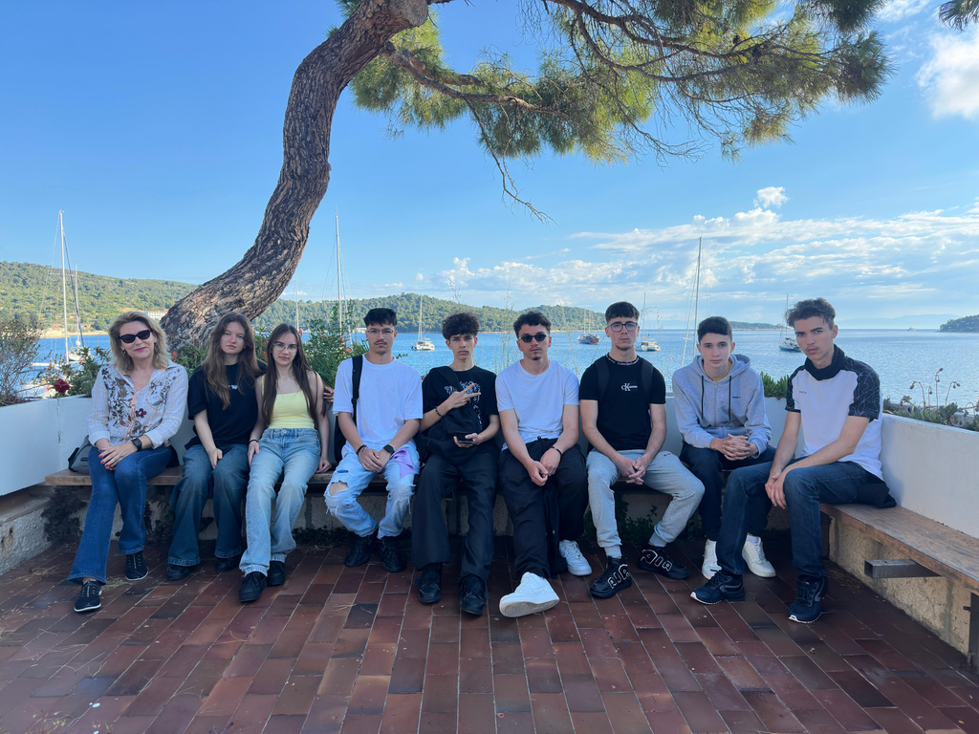
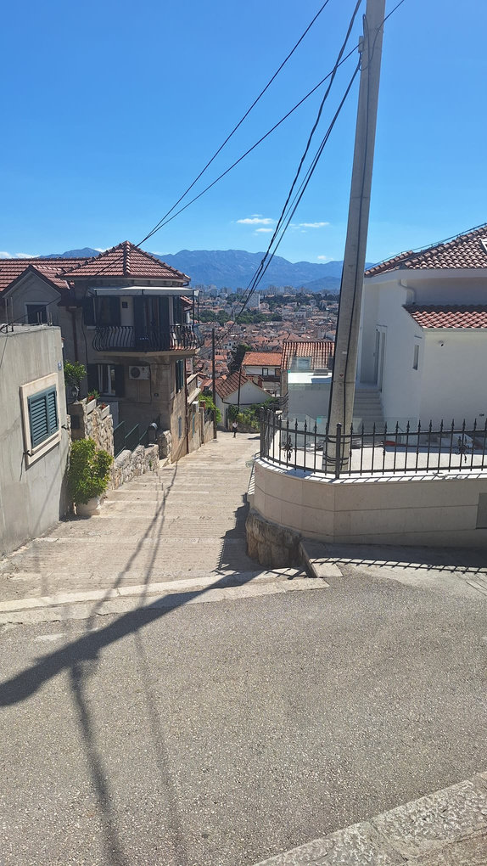
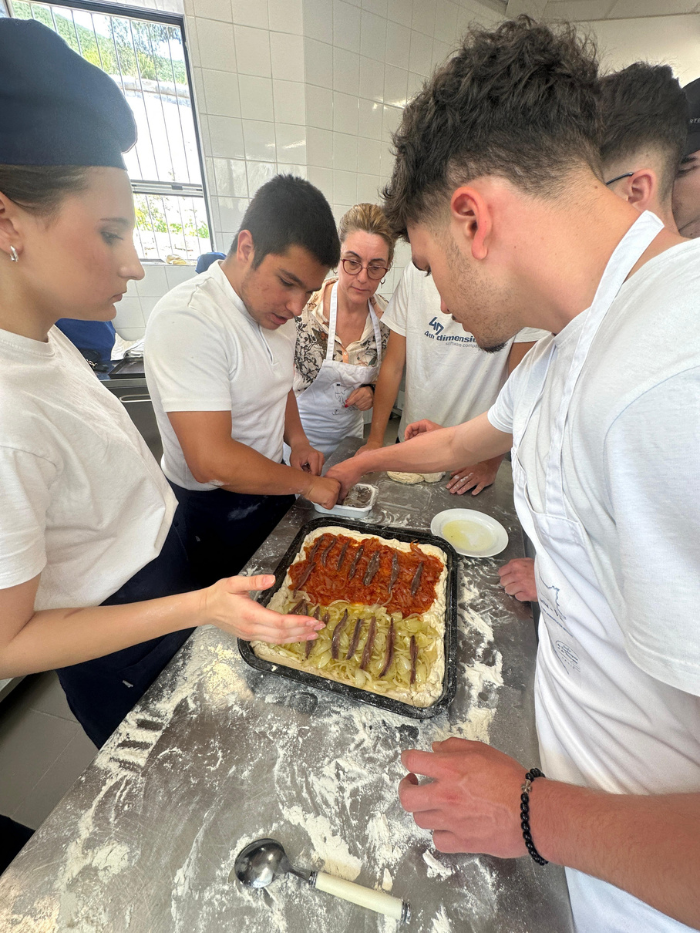
ERASMUS+ PROJECT: PRESENTING OUR SCHOOLS
Experience and Insights from the Mobility in Croatia

Slide 2
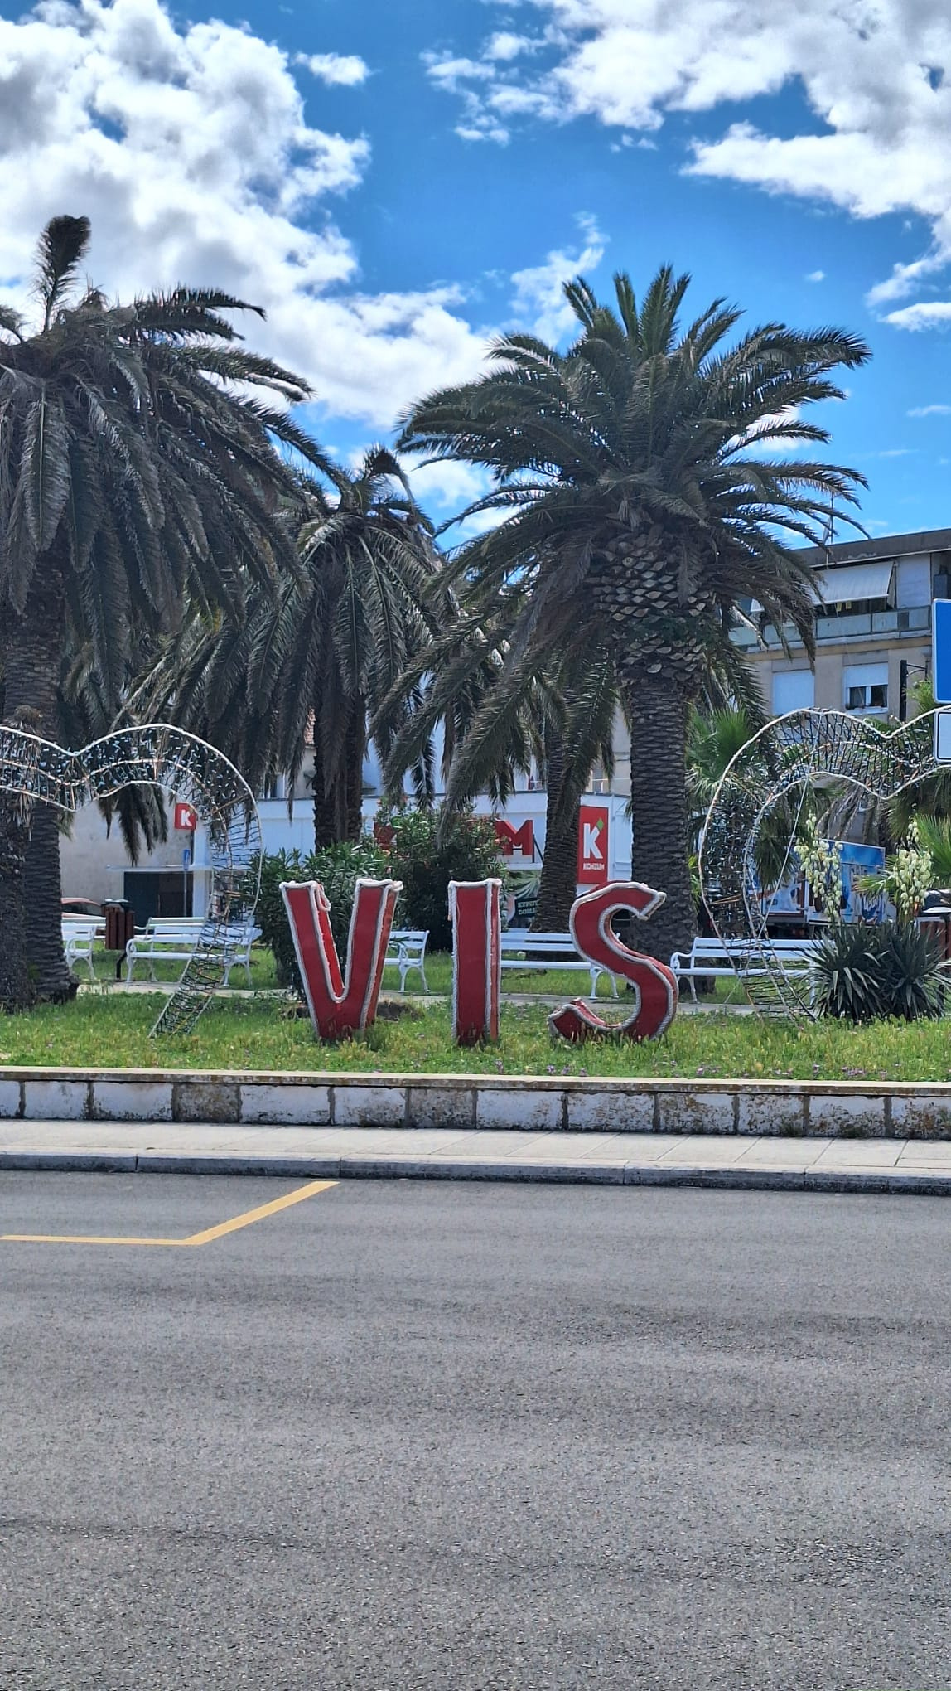
INTRODUCTION
During our Erasmus+ project, both schools had the chance to present themselves. First, the Croatian high school from Vis island introduced their school, followed by our presentation of Colegiul Tehnic Gheorghe Asachi in Focșani, Romania. The main goal of these presentations was to share information about our schools, education systems, and cultures, and to get to know each other better.

Slide 3
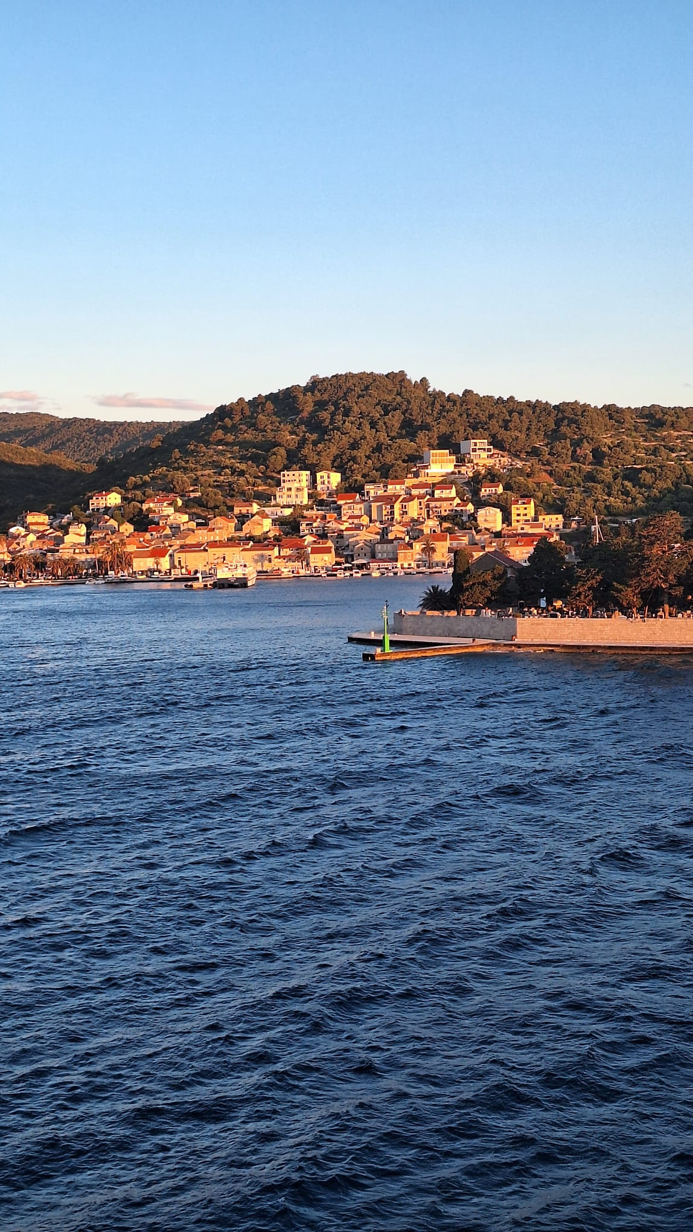
PRESENTATION BY CROATIAN SCHOOL
The Croatian school is located on Vis island and is a small, friendly high school. They emphasized their personalized approach to education, where teachers know the students well and focus on helping each one individually. They also spoke about environmental awareness and practical activities, which are important parts of their curriculum. Their presentation showed us how they value close relationships and real-world learning experiences.

Slide 4
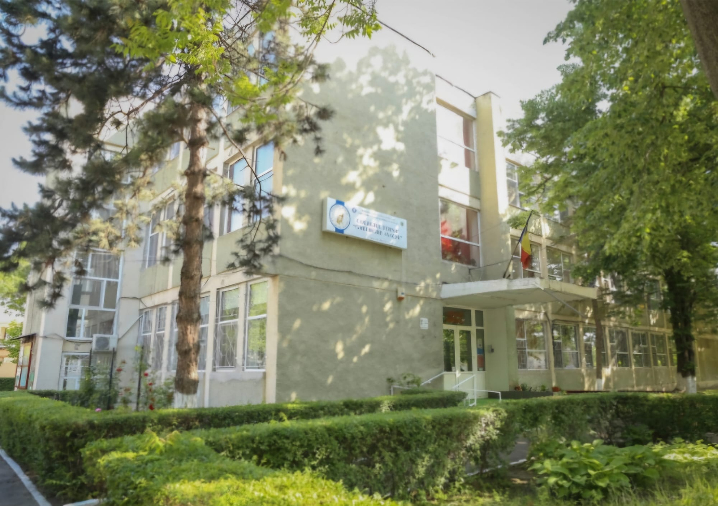
OUR PRESENTATION: COLEGIUL TEHNIC GHEORGHE ASACHI
When it was our turn, we introduced Colegiul Tehnic Gheorghe Asachi, located in Focșani, Romania. We explained that our school focuses on technological and theoretical domain. We also talked about our modern facilities, including well-equipped laboratories, and the many extracurricular activities available to students. Additionally, we shared information about Romanian culture, traditions, and history to help our Croatian peers understand our background better.

Slide 5
REACTIONS AND FEEDBACK
The Croatian students were very curious and asked several questions about our school and culture. They showed positive interest in our technical education and were especially fascinated by Romanian traditions, food, and music. Their questions and comments made it clear that they enjoyed our presentation and that it sparked their interest in Romania. Some even expressed the wish to visit our country and school in the future.

Slide 6
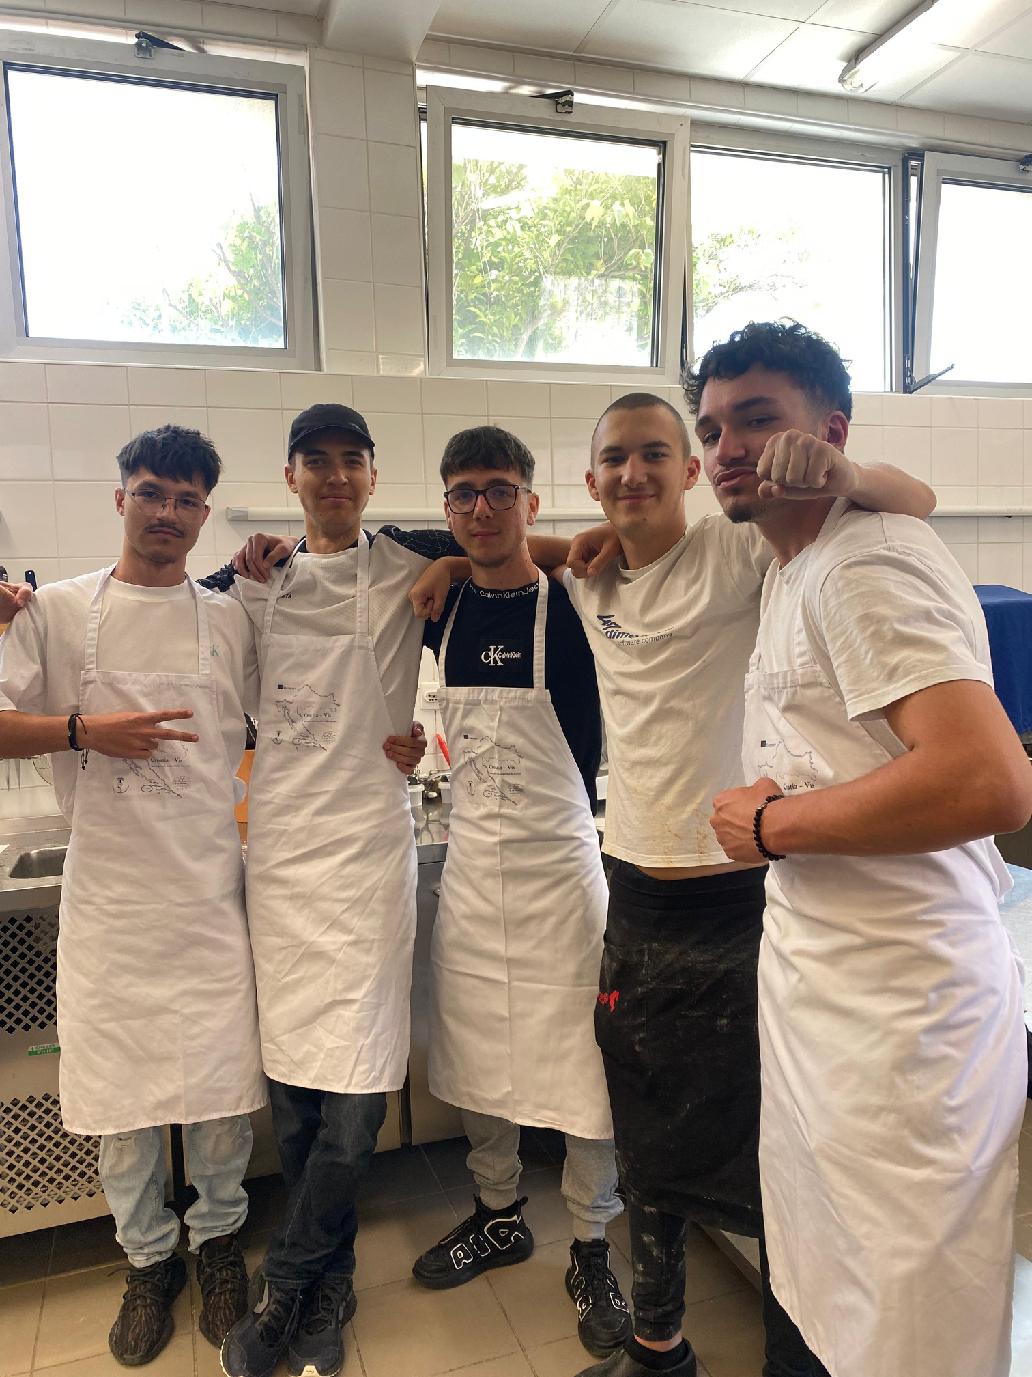
PERSONAL EXPERIENCE
This experience helped me grow and step out of my comfort zone.
Although I was nervous at first, I managed to connect with new people and enjoy every moment.
One of the most joyful parts was seeing how well we presented our school and culture.
I discovered that I can be more confident, open-minded, and adaptable than I thought.
After this mobility, I want to keep improving my communication skills and learn even more about different culture

Slide 7
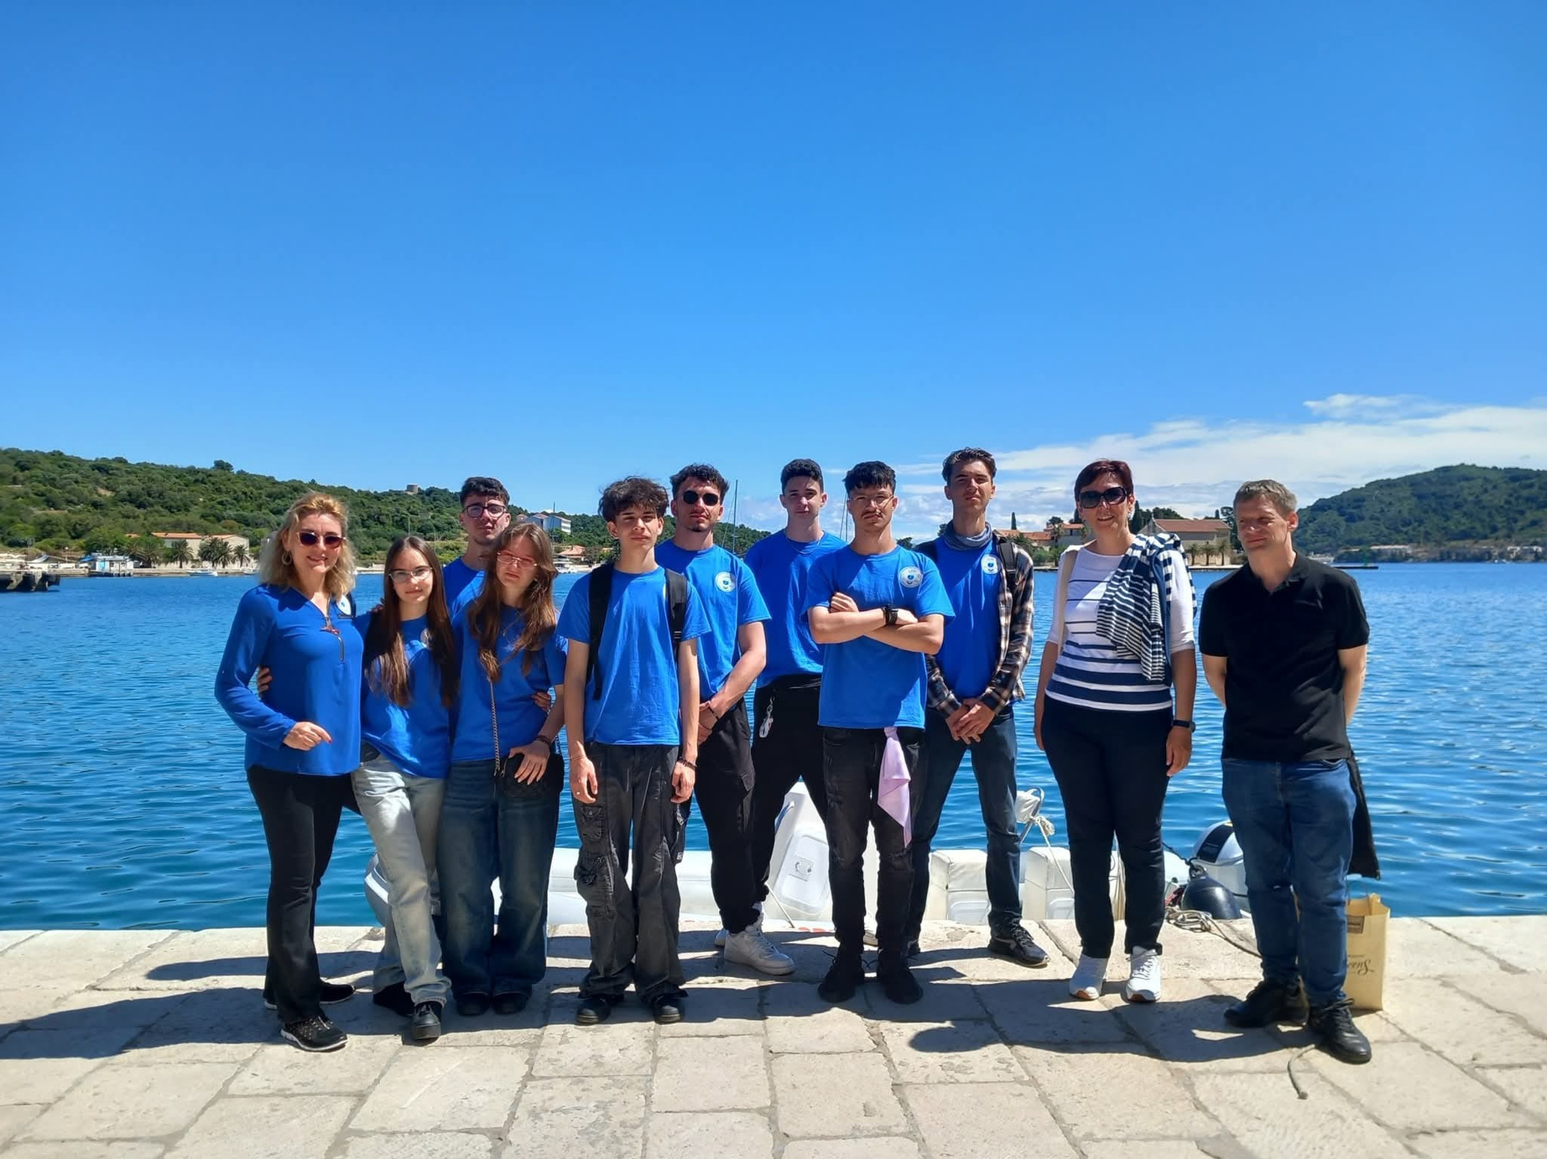
CONCLUSION
This presentation was a great opportunity to build connections and mutual understanding between our two schools. It encouraged cultural exchange and friendship, helping us appreciate both similarities and differences. Personally, this experience motivated me to participate in more Erasmus+ projects in the future, as it shows how valuable these international exchanges are for learning and growing.

