Slide 1
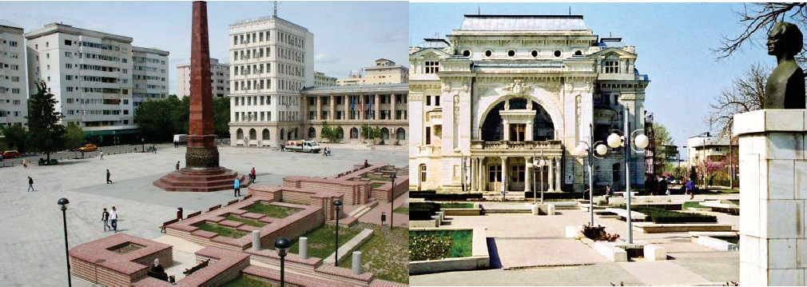

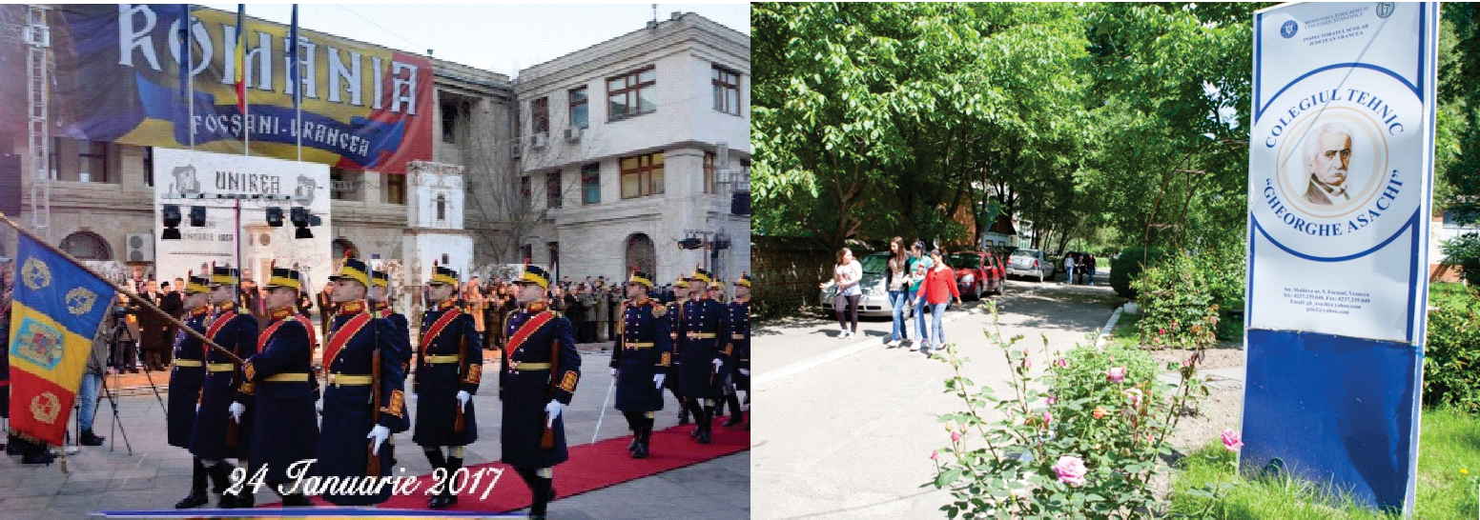

Slide 2




Colegiul Tehnic "Gheorghe Asachi" Focsani is a VET public educational institution which has provided education and training since 1883. It is located in South -East of Romania, in a medium sized-town called Focsani, in Vrancea County.

Slide 3
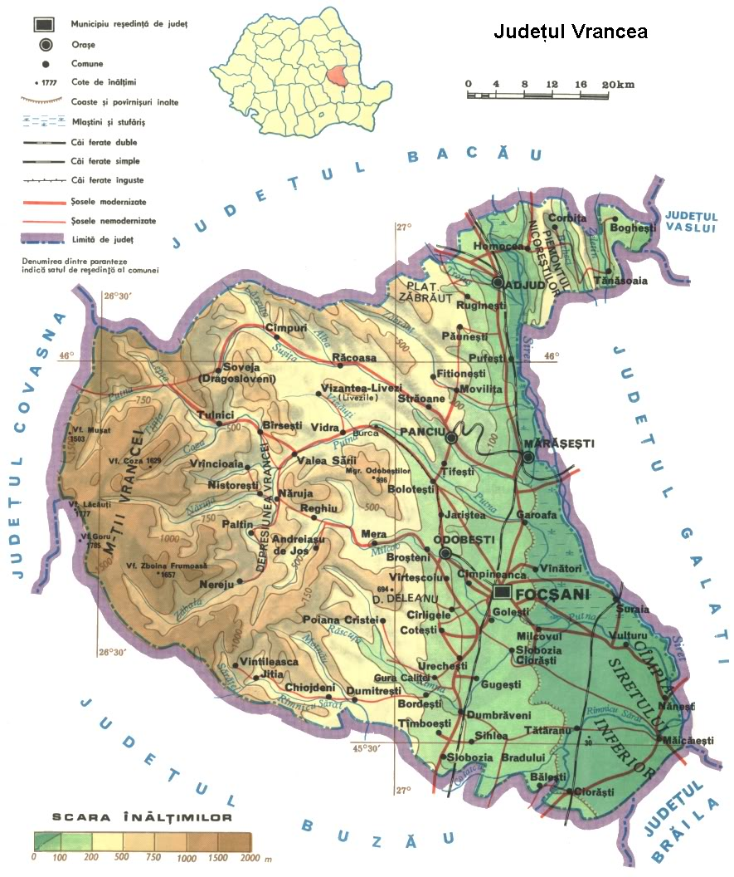
Focșani - Vrancea, the land where history meets legend
The land with rich forests Varancha, as it has been attested for the first time in 1431 Vrancea.
Because of its geographical position, at the curvature of Oriental Carpathians, Vrancea has been, during the times, a real connection point between Moldova, Țara Româneasca (Muntenia) and Transilvania.

Slide 4
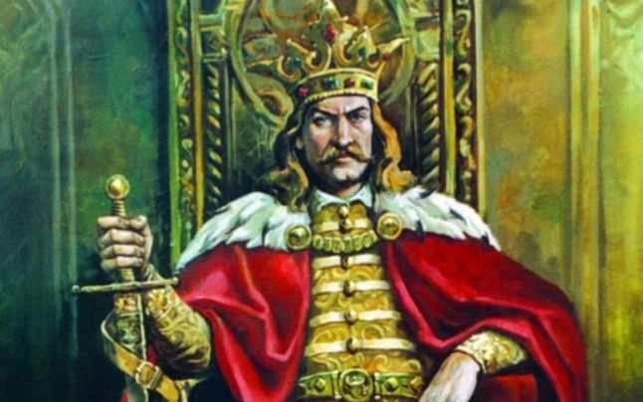
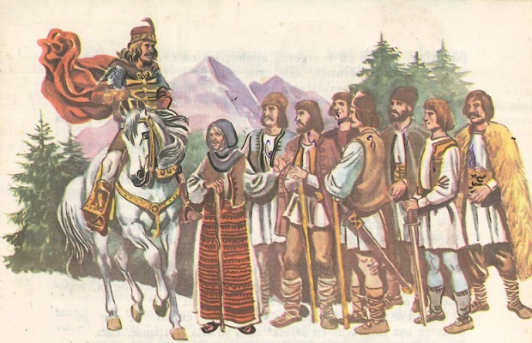
Focșani - Vrancea, the land where history meets legend
Link:
https://www.youtube.com/watch?v=kzneWb-DnJ0

Slide 5
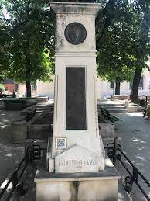
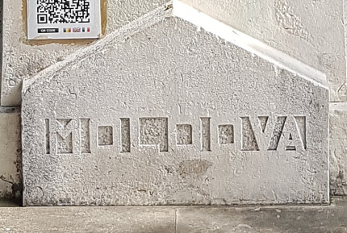
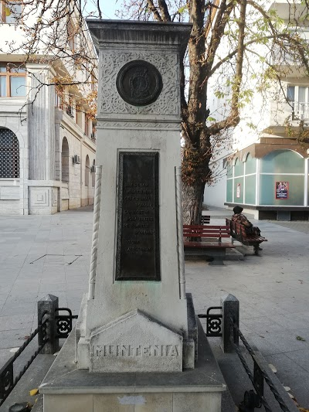
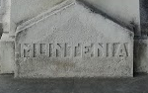
Focșani - Vrancea, the land where history meets legend
In the contemporary period, Focsani was the symbol of Romanian freedom and dignity, the symbol of the union between Moldavia and Muntenia (Wallachia) on January 24, 1859, which laid the foundations of the modern Romanian state. Focşani was the centre of the first institutions of the new unified Romanian state: the Central Commission and the Court of Appeal.

Slide 6
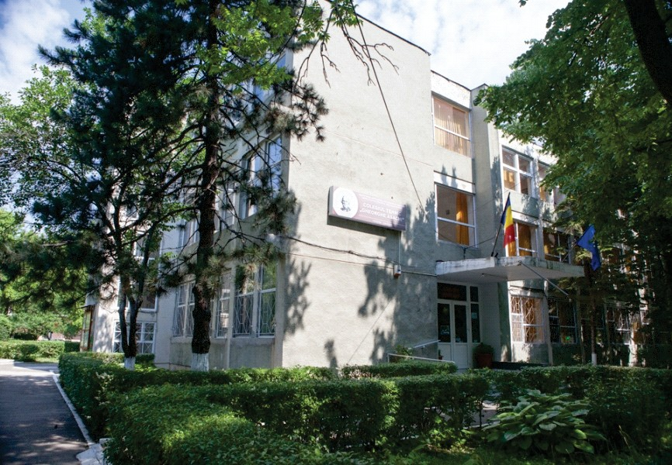
COLEGIUL TEHNIC „GHEORGHE ASACHI”
FOCȘANI – VRANCEA

Slide 7
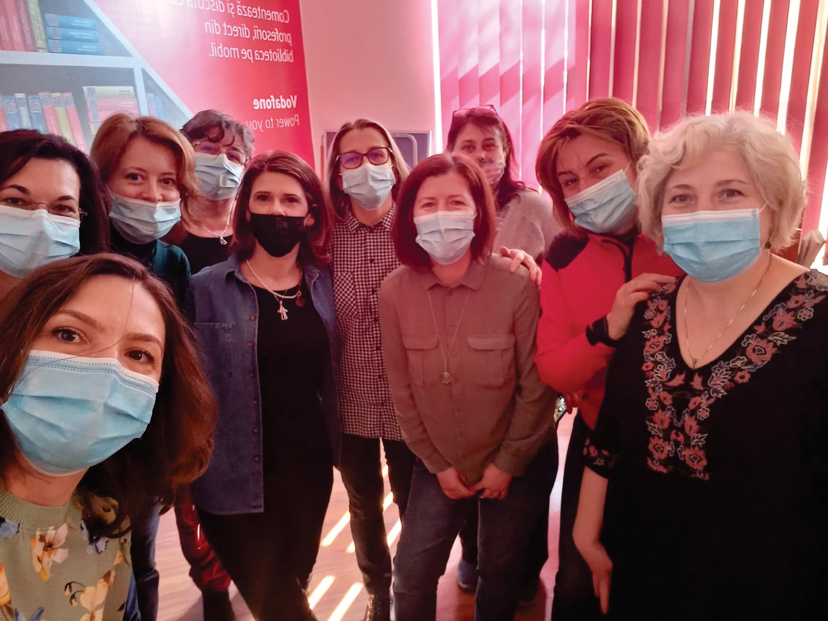


Team project – ACCORD WE GROW TOGETHER!
2020-1-RO01-KA101-078593
Analyze Communicate Connect Open Reflect/Relax Develop

Slide 8
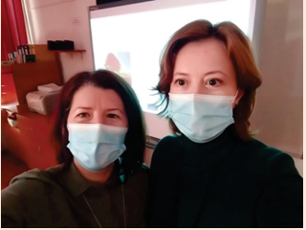
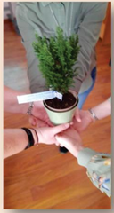



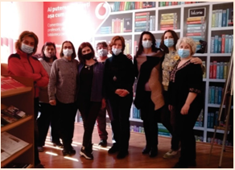
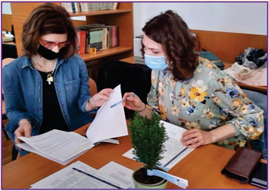
Team project – ACCORD WE GROW TOGETHER!
2020-1-RO01-KA101-078593
Analyze Communicate Connect Open Reflect/Relax Develop

Slide 9





Our college has now 46 teaching staff, 36 auxiliary staff and 560 students.
Due to a significant decrease of textile industry, in 2007 we decided to diversify our school offer with three new qualifications in hospitalities: banqueting organiser, gastronomy technician and tourism agent because these professions are more wanted on the labour market.

Slide 10
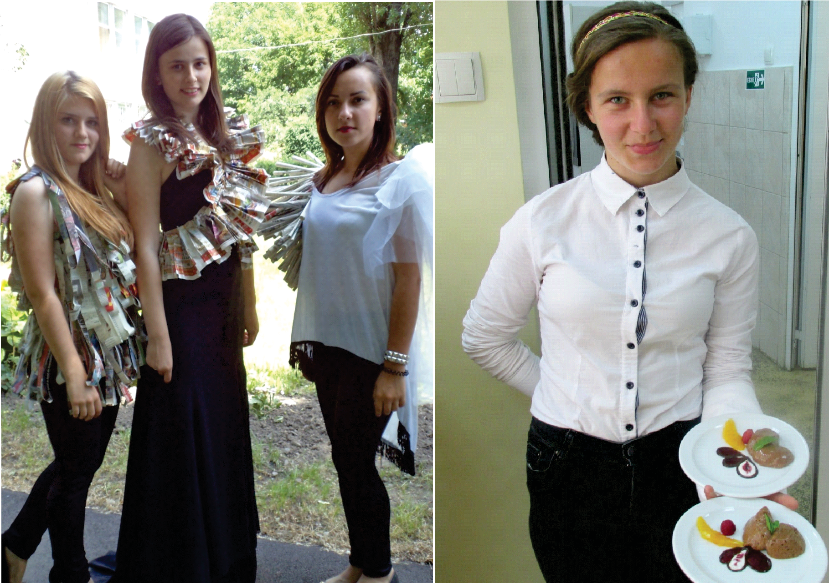

Slide 11
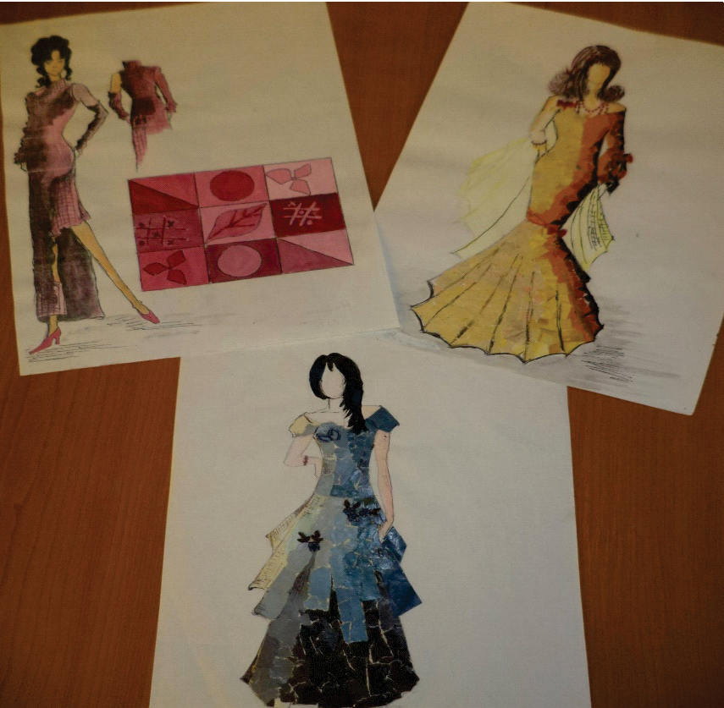
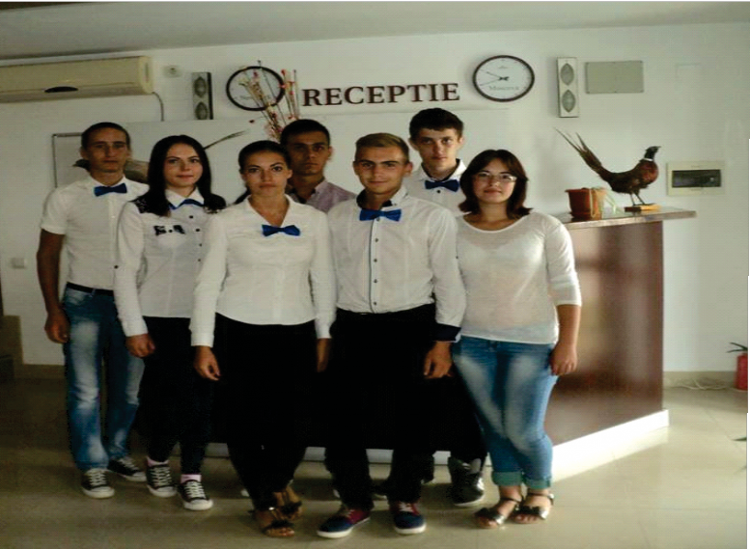

We offer our students (aged 14-19) theoretical and practical training in textiles, tourism and hospitalities through 4-year highschool studies and 3-year professional school studies according to the Romanian laws of education.

Slide 12
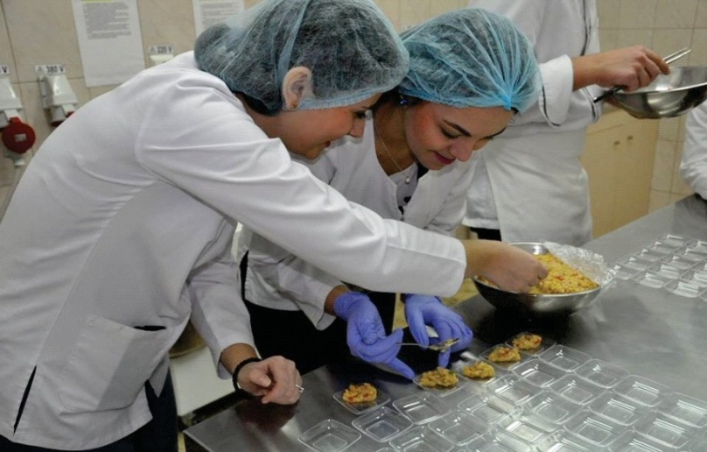
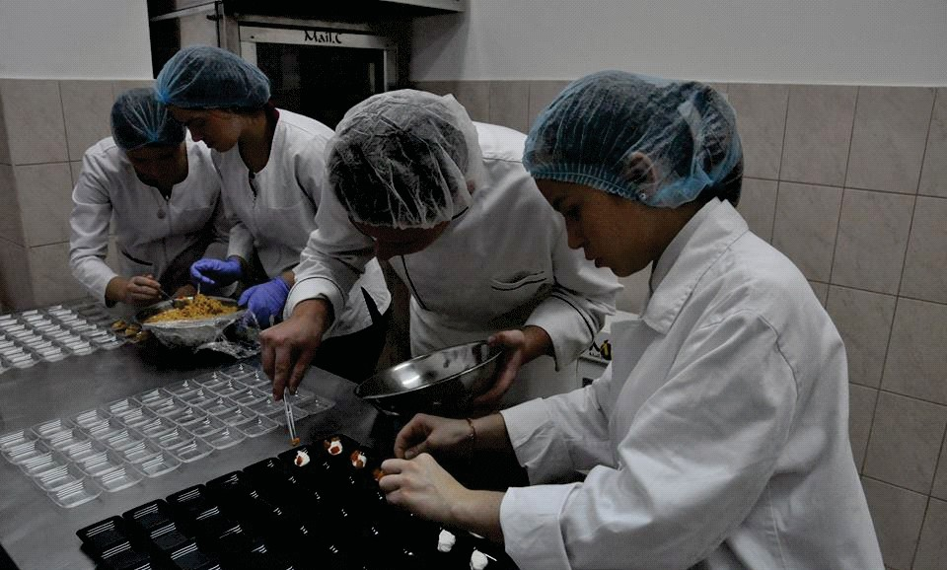
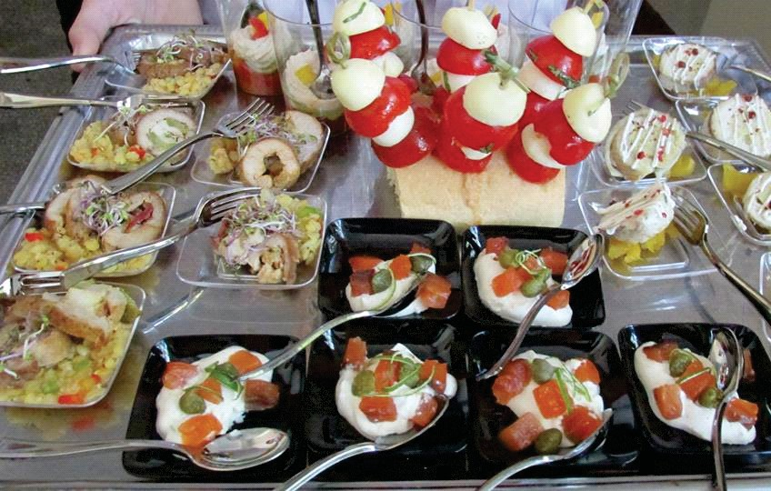
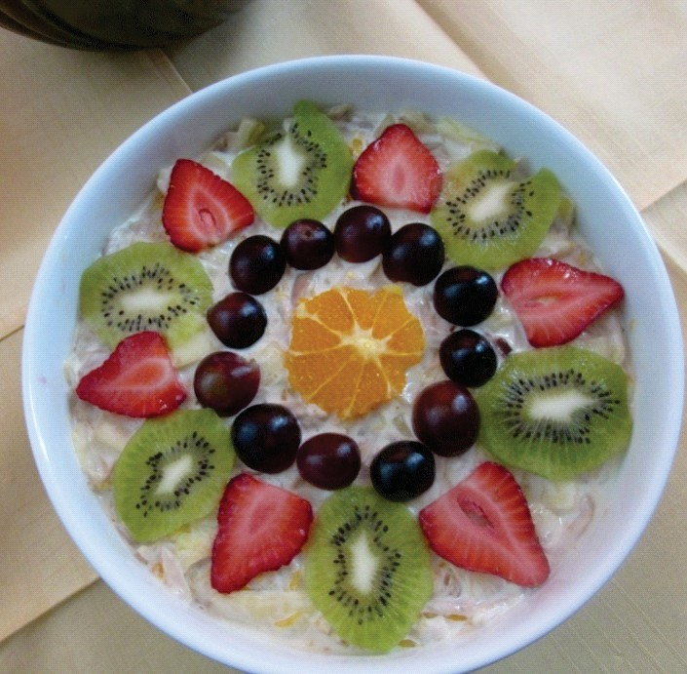

Slide 13

We also provide highschool evening classes for adult students who abandoned their studies and who want to complete their education.
For those interested in continuing education in the study domain, we offer 2 year-post-highschool studies in the field of textile industry and hospitality.

Slide 14
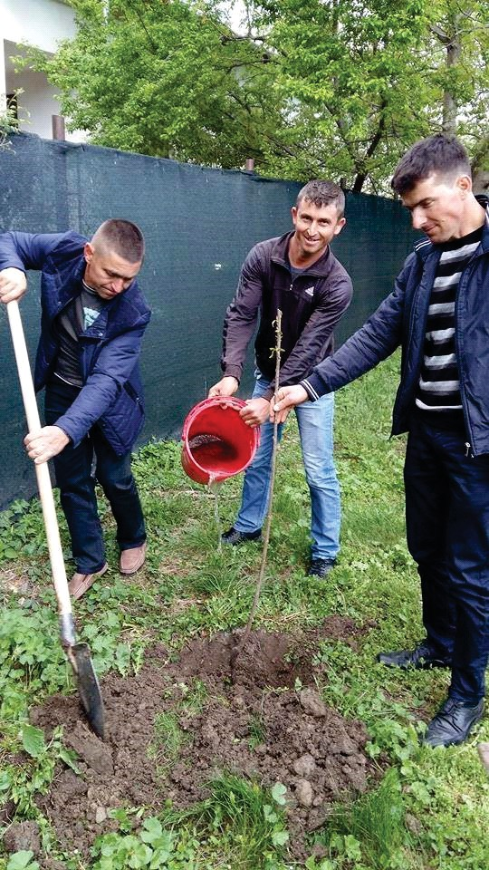
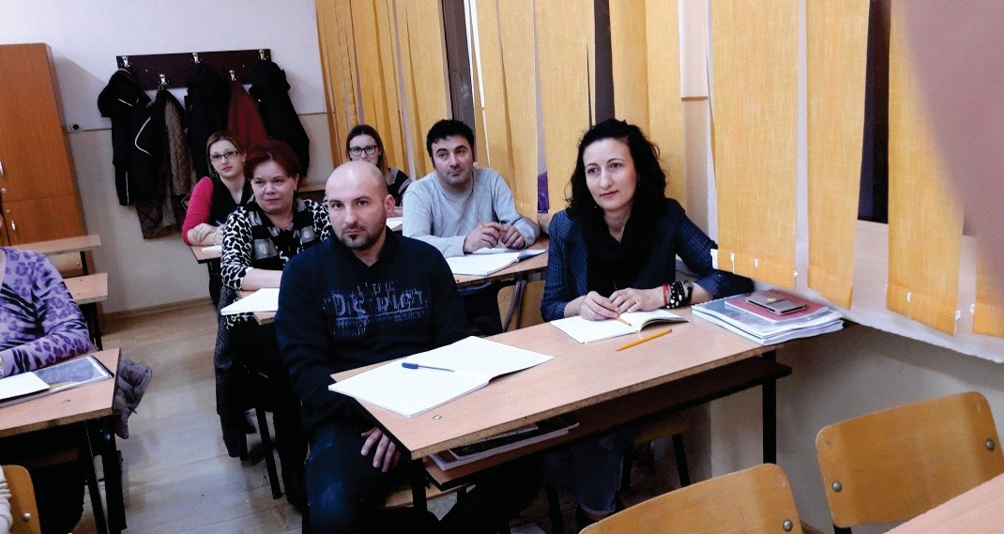
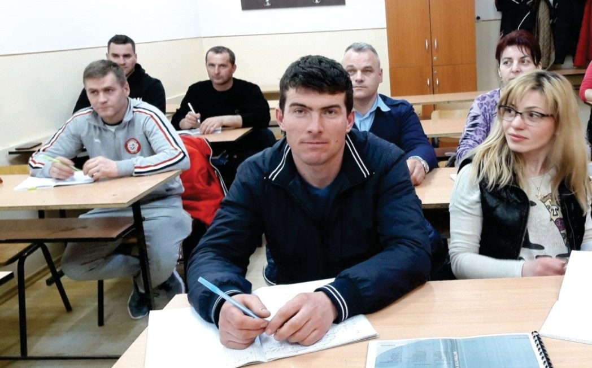

Slide 15


80% of our students come from surrounding rural areas, most of them being commuters or living in our college boarding school.

Slide 16
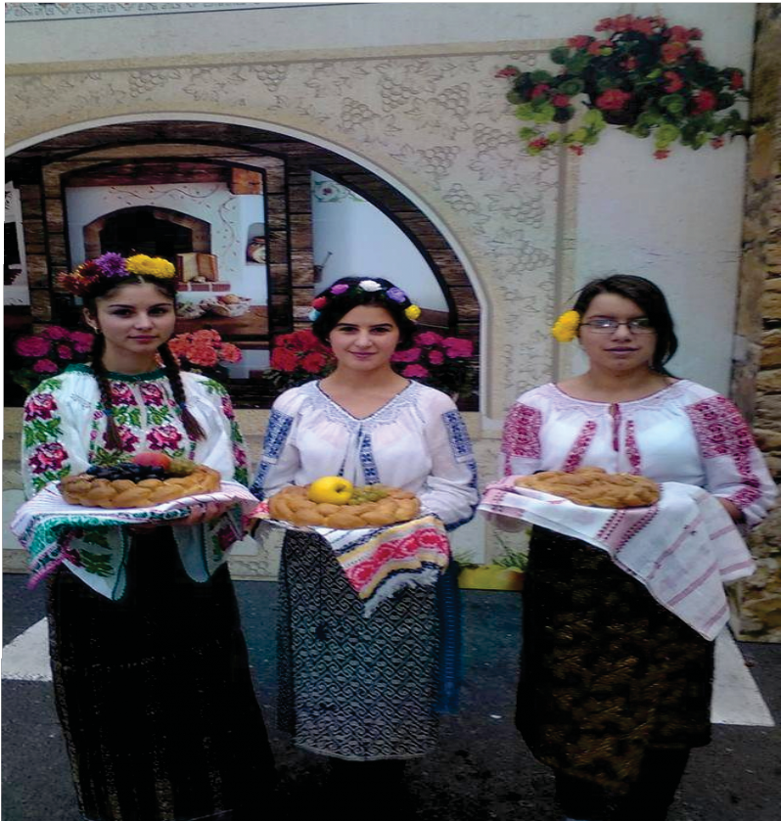
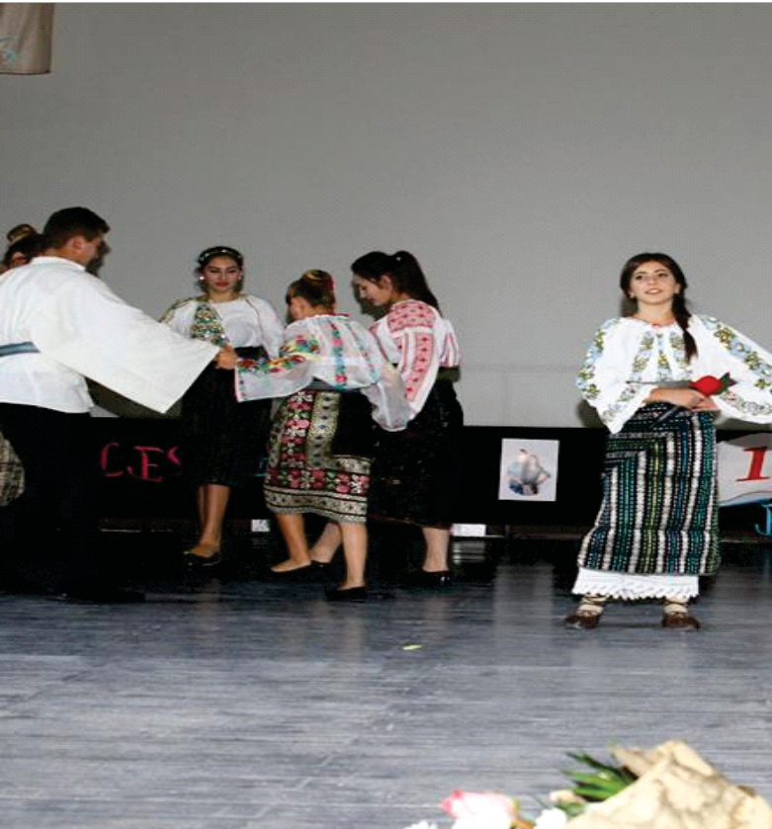

Slide 17

The mission of our college is based on the community needs to have efficient educational institutions that provide well trained students able to integrate in the labour market or to continue their studies, to educate youngsters and adults including those who come from disadvantaged environments according to European standards by rapid and efficient social and professional integration which contributes to quality growth of life in the local community.

Slide 18
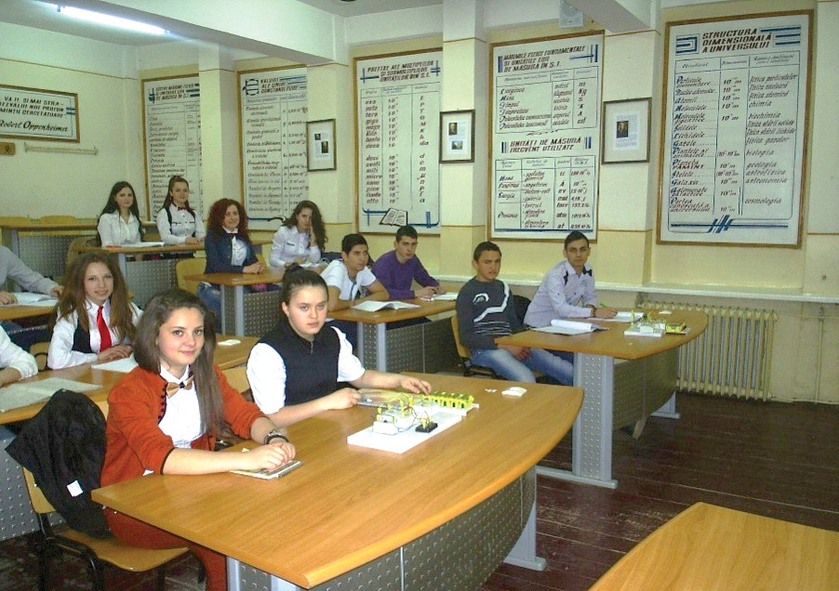
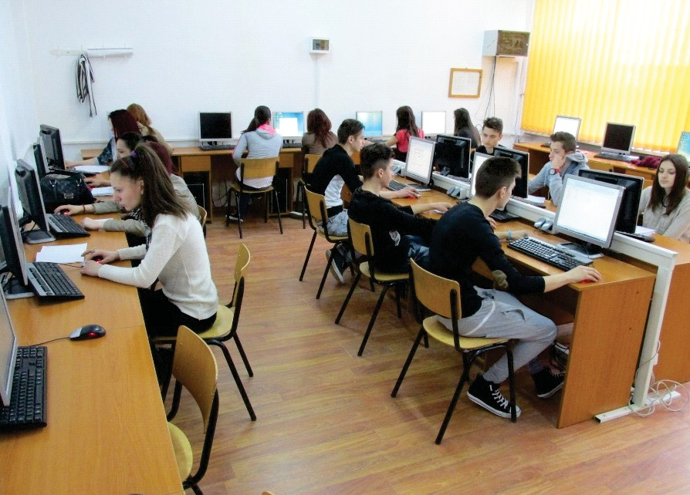
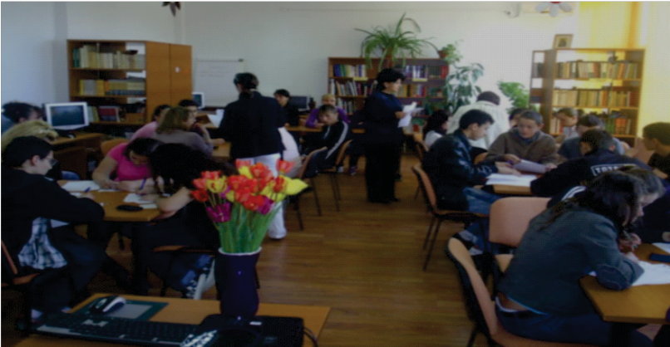
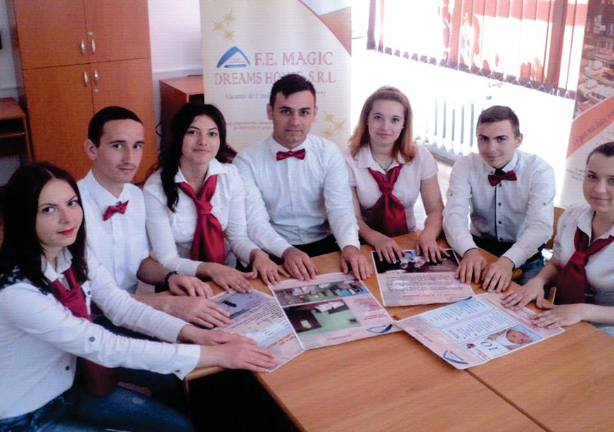

Slide 19


The values of our college are: offering equal development chances to all students and teachers, a wide range of qualifications and types of educational forms, collaboration with local community representatives and with the students' families.

Slide 20
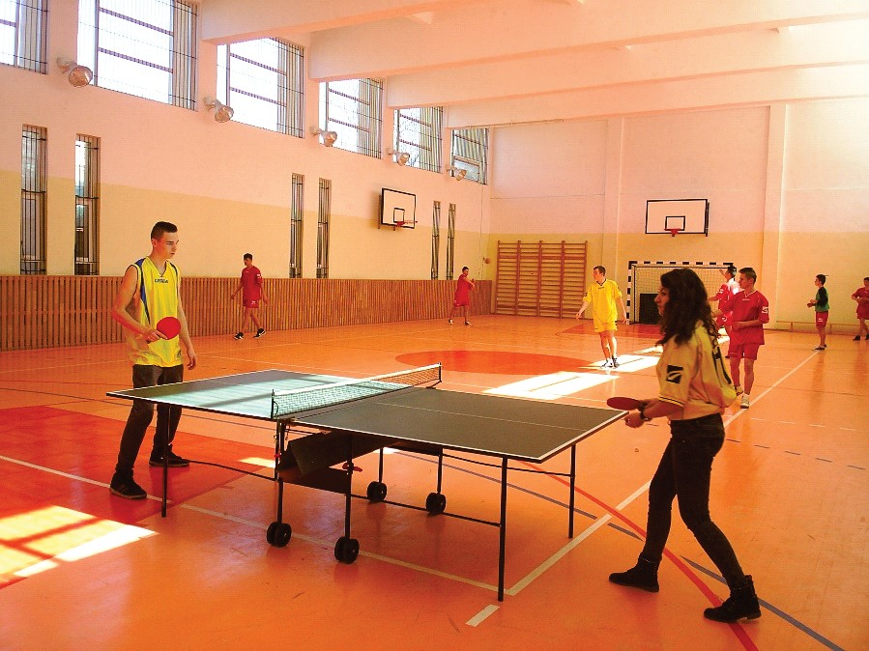
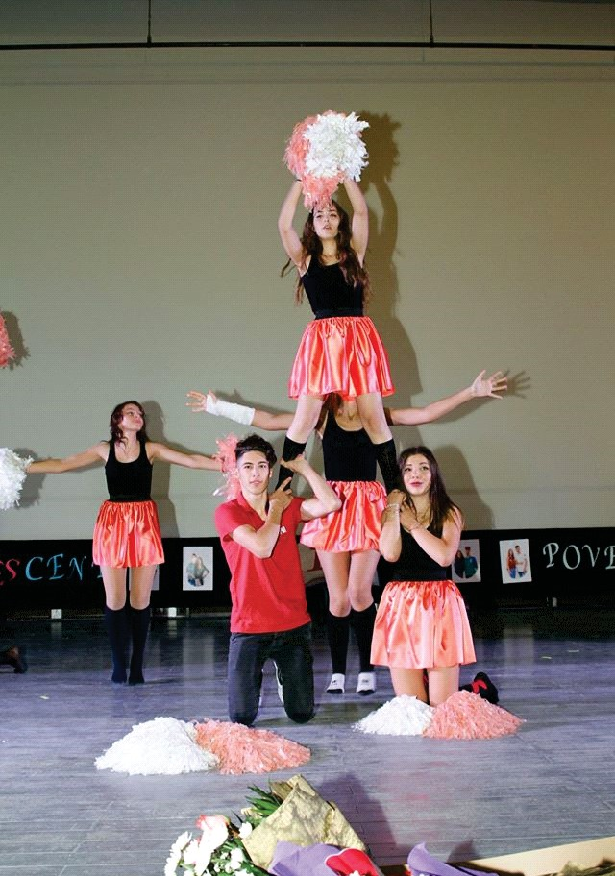
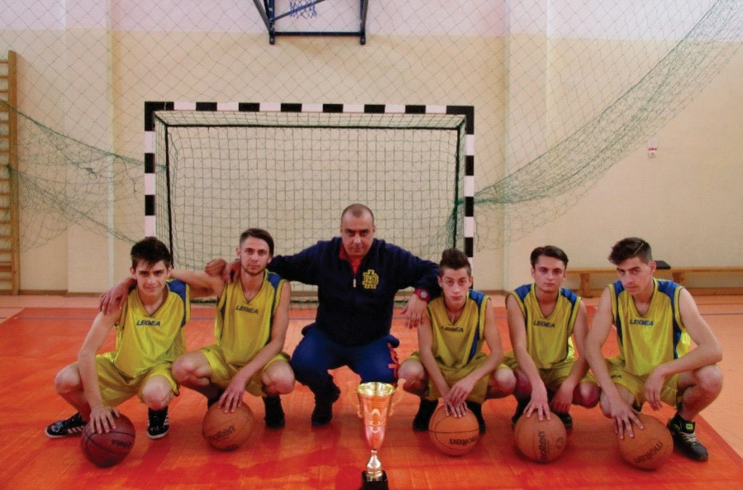

Slide 21
Our vision is to have more motivated management and teaching staff able to organize their professional career independently and with dignity, to facilitate better social and professional integration of students in the European community and to integrate the staffs personal and professional developments into 2014 - 2020 European strategy through the promotion of international cooperation, digital learning, language learning and linguistic diversity derived from opportunities professional and learning experiences in other countries.

Slide 22
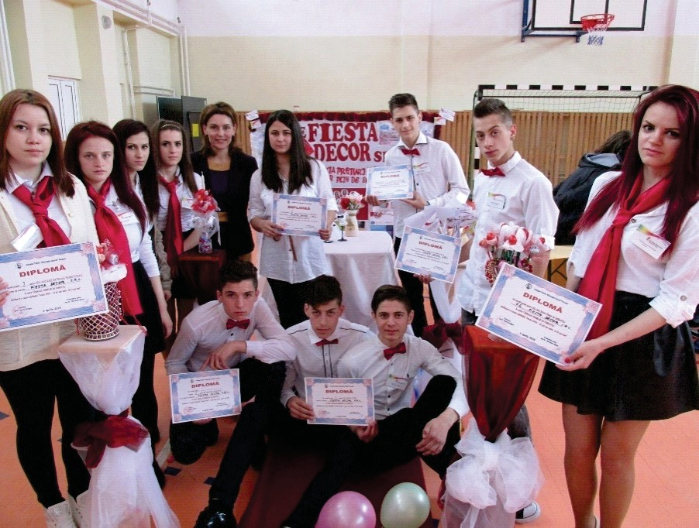
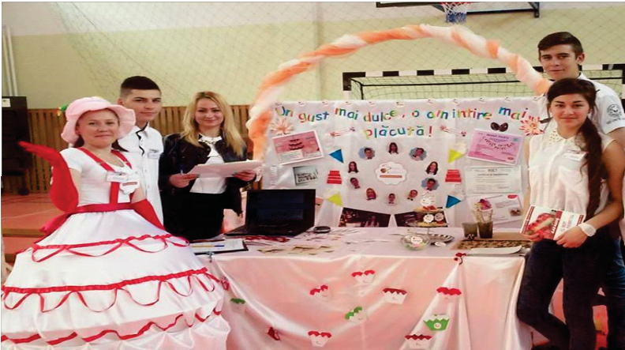
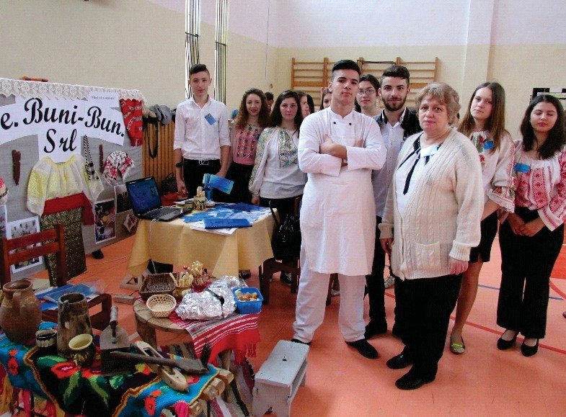
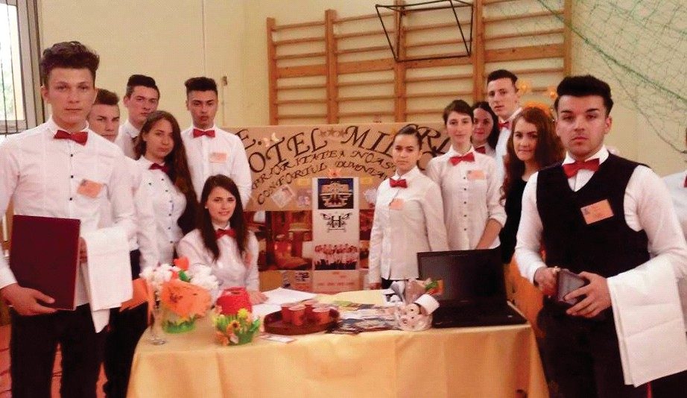

Slide 23


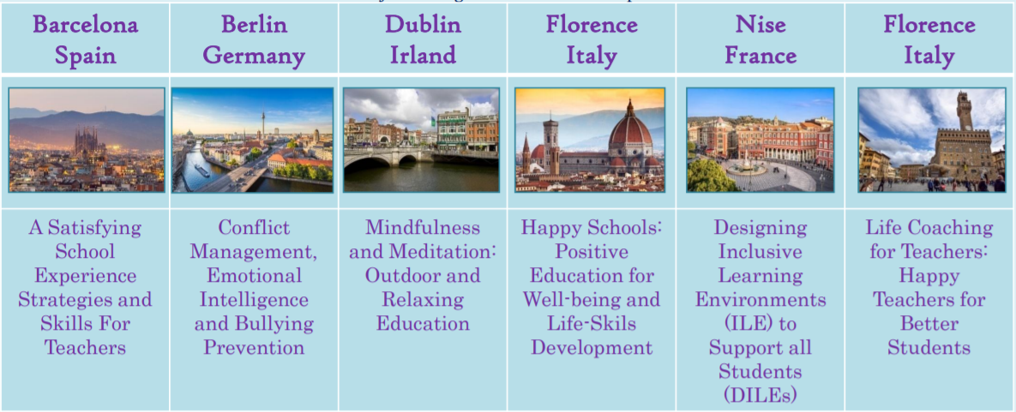
ACCORD WE GROW TOGETHER!
2020 -l -RO0l -KAlO l -078593
euro ::.::.,
pass
Colegiul Tehnic "Gheorghe Asachi" Focșani - Romania Europass Teacher Academy - Italy
Project Management Plus S.L.U - Spain

Slide 24



ACCORD WE GROW TOGETHER!
2020-1-RO01-KA101-078593
Colegiul Tehnic “Gheorghe Asachi” Focșani
Analyze Communicate Connect Open Reflect /Relax Develop

Slide 25
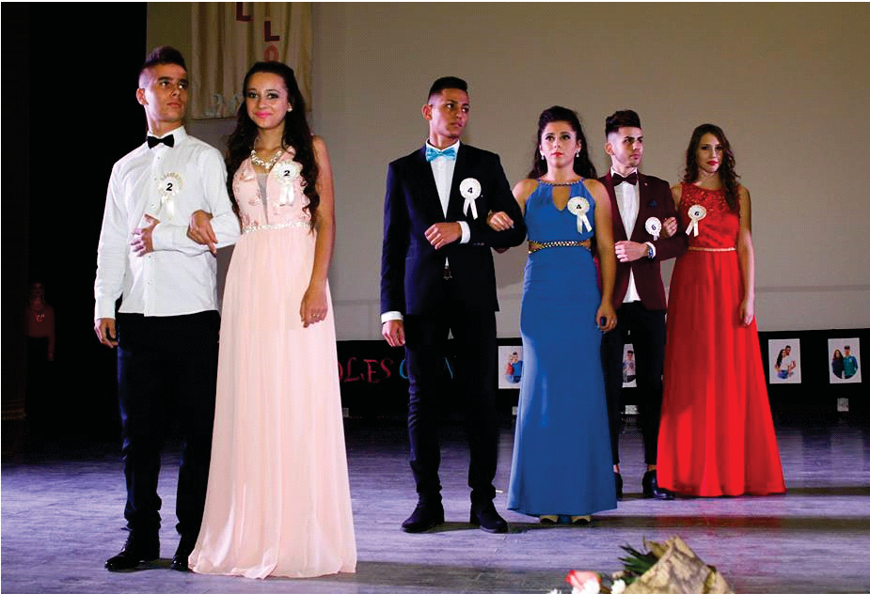
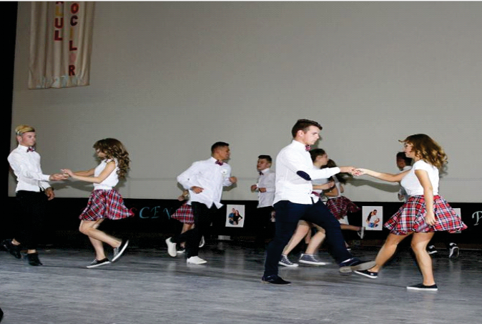
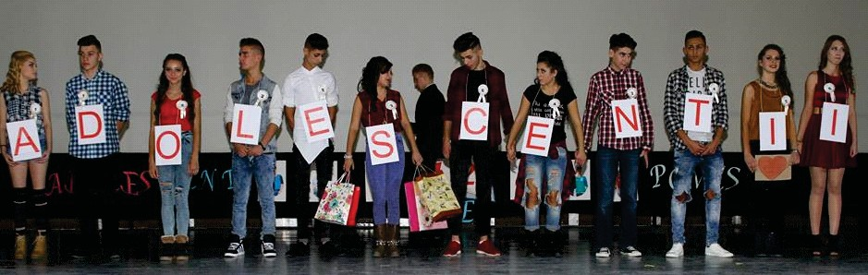

Slide 26
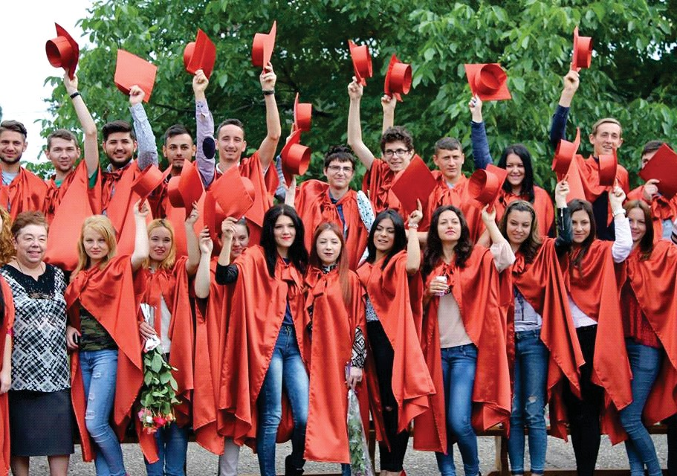

Slide 27
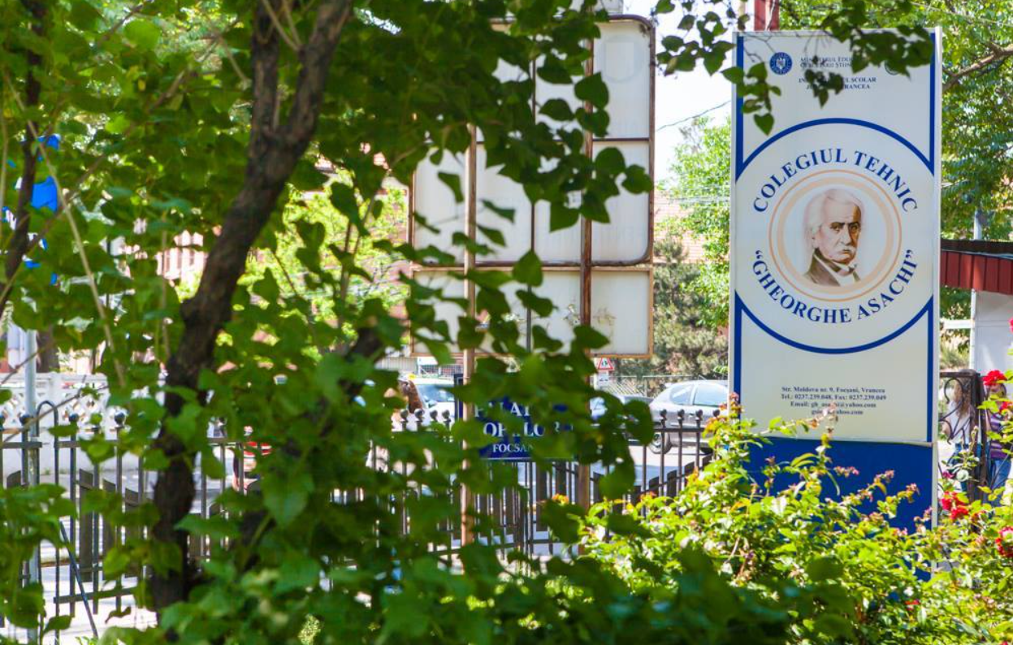
We are waiting for you in Focșani!

