Slide 1

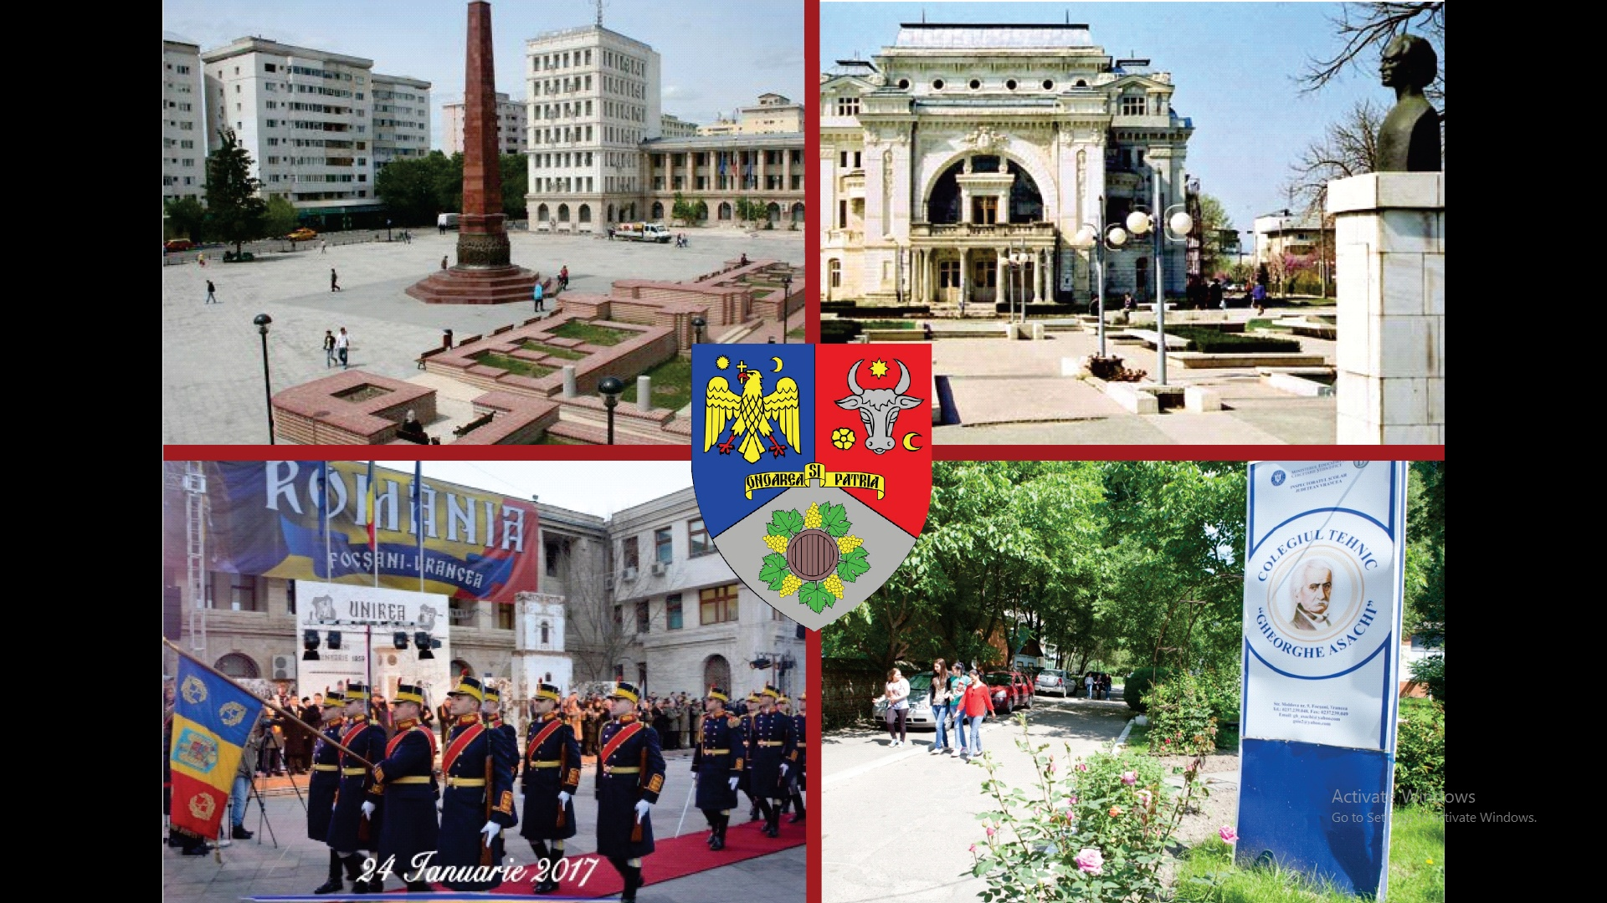
Colegiul Tehnic "Gheorghe Asachi"
-A VET/Technical public educational institution which has provided education and training since 1883
- Located in South–East of Romania, in a medium sized-town called Focşani, Vrancea County
Strada Moldova 9, 620166 Focşani – Romania PIC 945259278 OID E10029706

Slide 2

Let’s fly … ROMANIA ! https://www.youtube.com/watch?v=Qyca2RB9Kek

Slide 3

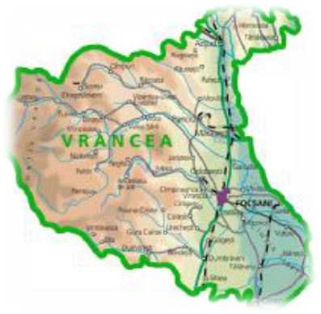
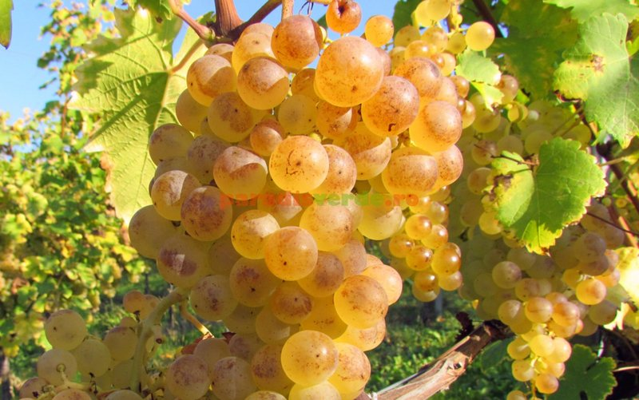
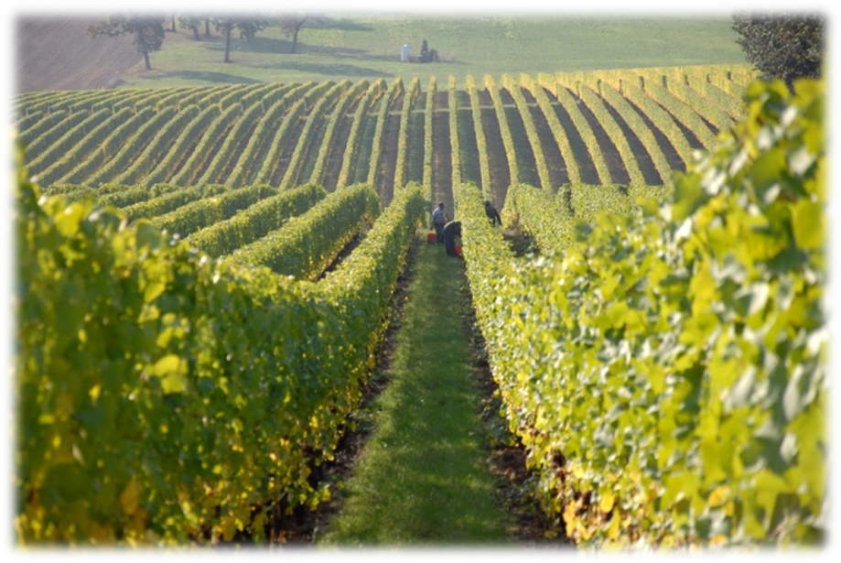
VRANCEA, also called the County of Wines and Vineyards, is situated outside the Curvature Carpathians, at the crossroad of the three historical regions:
Moldova, Muntenia and Transilvania.

Slide 4

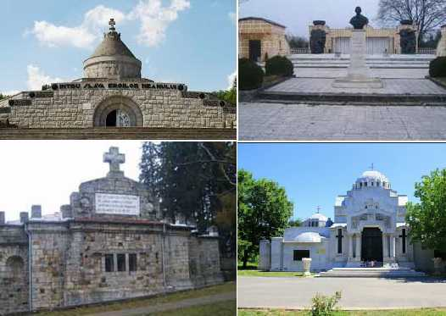
VRANCEA is the symbol of the Union from 1859, that laid the foundations of the Romanian state. Focșani is known as the first capital of the United Principalities. World War I represents another important stage, and the Mausoleums from Focşani, Mărăşti, Mărăşeşti and Soveja are here to constantly remind us of this stage.

Slide 5
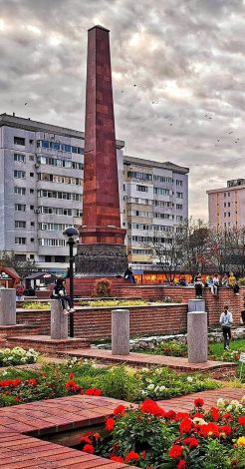
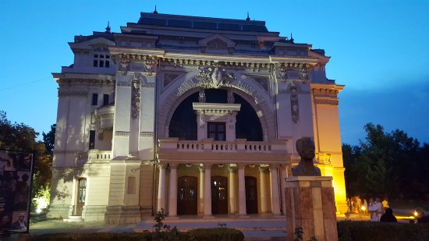
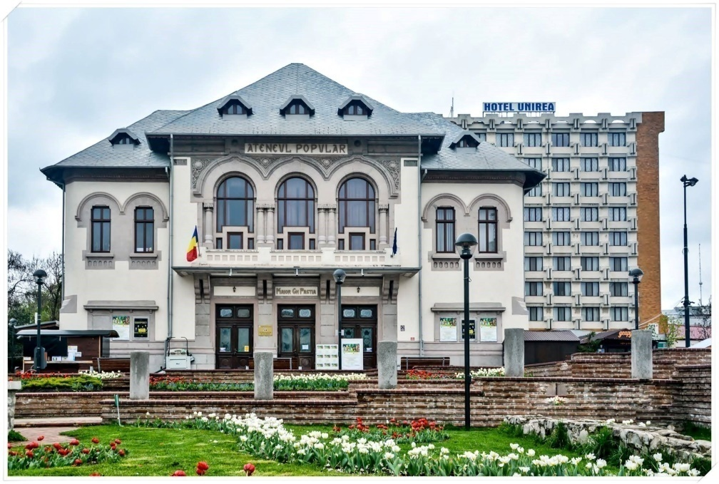
FOCȘANI is the residence city of Vrancea County (the most active seismic area in Romania), bordering 2 historical regions of the country - Moldova and Muntenia.
Location: in the east part of Romania, approximately in south-east of the county.
Surface: 54.8 km²
Population: 71.000 people
Focșani, known in many writings as "City of the Milcov river" entered into people's consciousness as "Union City“.

Slide 6
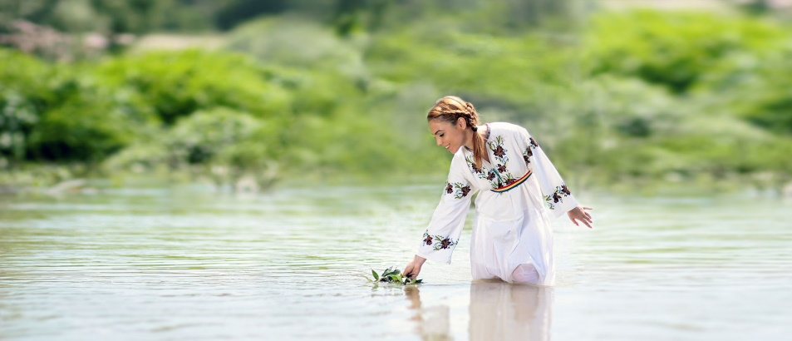
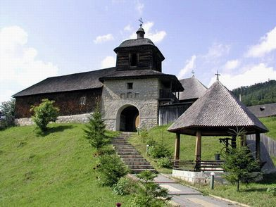
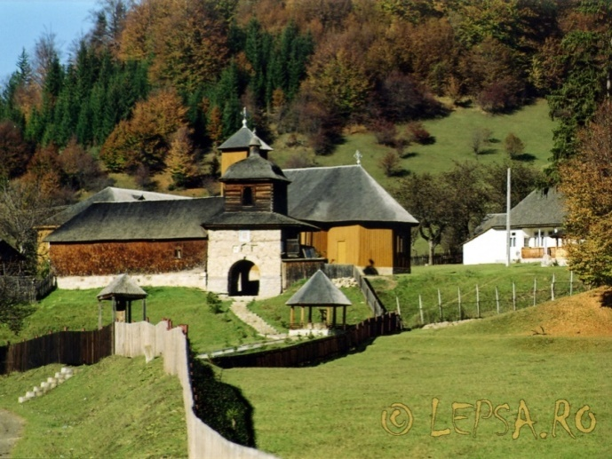
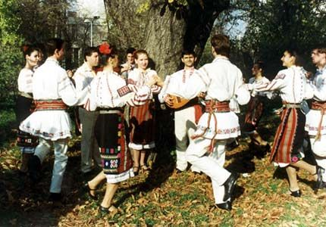
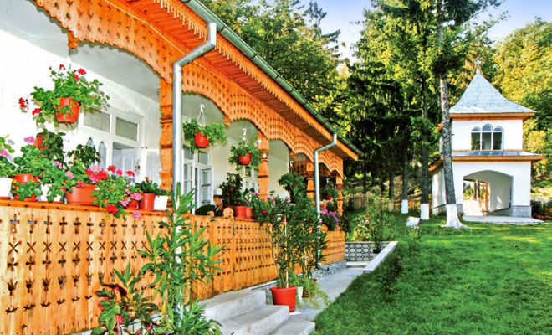
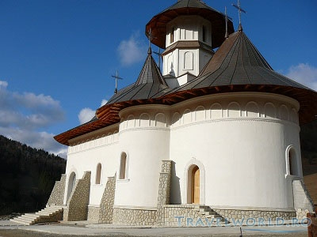
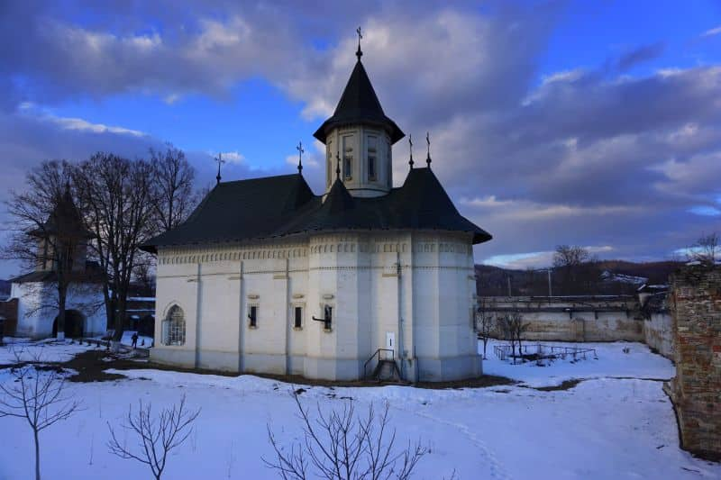
In terms of spirituality, the churches and the monasteries are speaking of a civilization with roots anchored in time and faith, unwavering in God.
The people from this part preserve even nowadays the traditional crafts, and the traditional outfit illustrate the ethnographic continuity and unity of the Romanians.

Slide 7
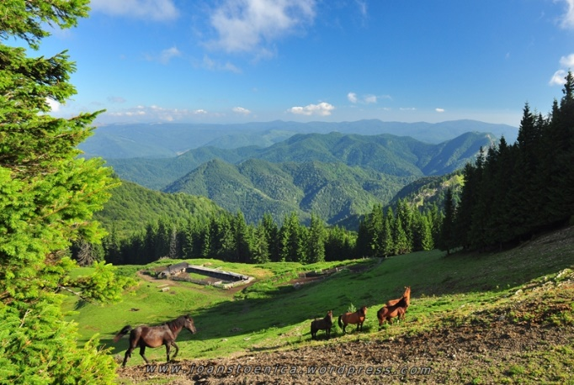
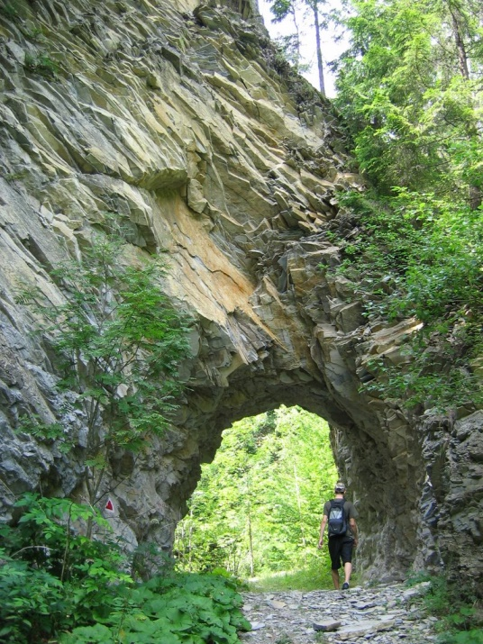
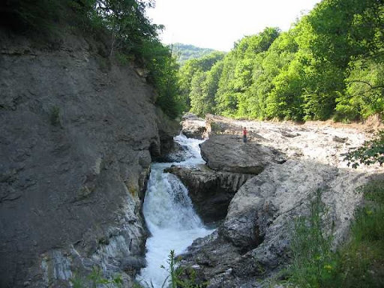
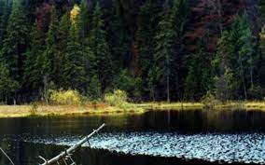
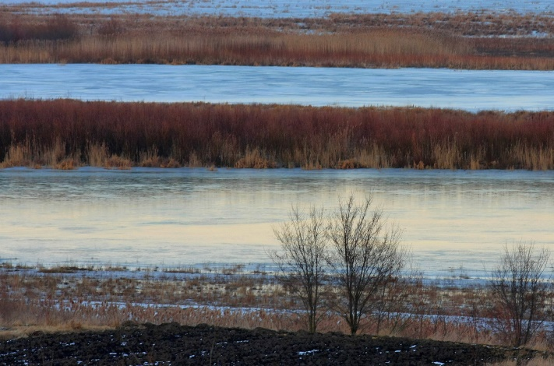
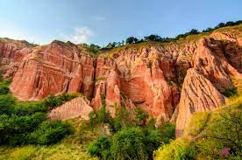
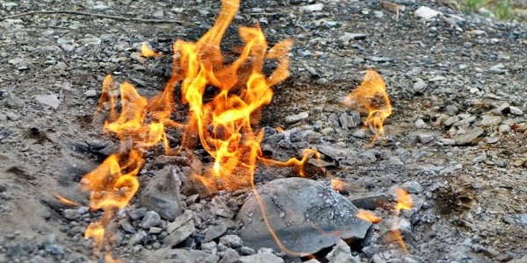
This blessed land is a Romania in miniature. Here we find all the relief forms: wild mountains, rich plains, slow hills that are bearing the vineyards with noble grapes.
In a natural landscape of a special picturesque we find Putna Waterfalls, Tisita Gorges, The Black Lake of Năruja Natural Reservation, Râpa Roșie Trout farm, Meadow Siret, the Alive Fire from Andreiașu, unique in the country.

Slide 8
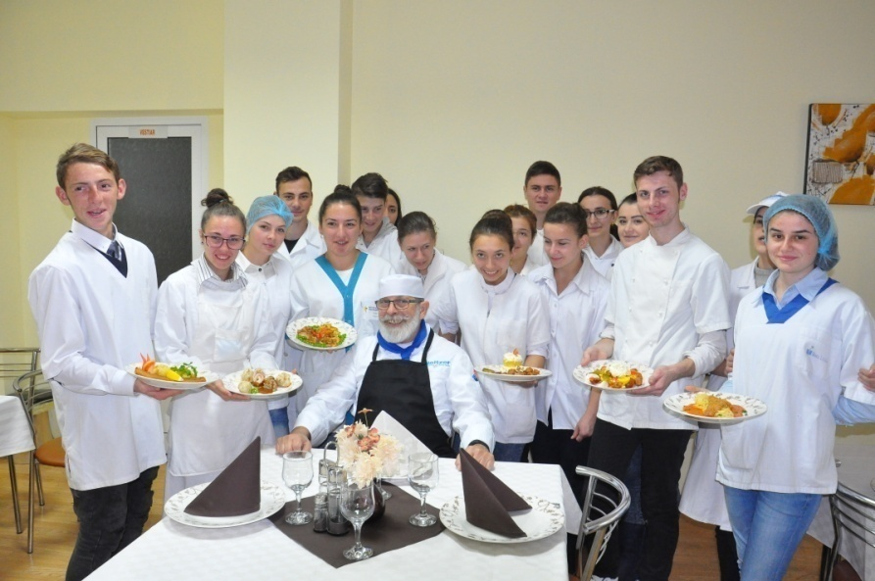
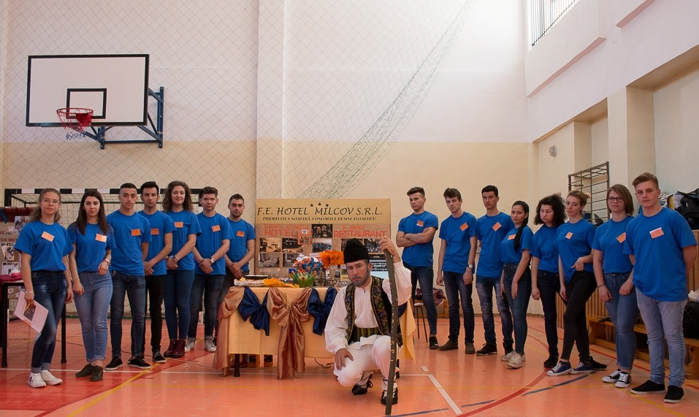
ABOUT US
- 46 teaching staff, 36 auxiliary staff and 560 students.
- Since 2007, our school offers three qualifications in hospitalities: Banqueting Organiser, Gastronomy Technician and Tourism Agent.
- We offer our students (aged 14-19) theoretical and practical training in Tourism and Hospitality through 4-year highschool studies and 3-year professional school studies.
- We also provide highschool evening classes for adult students who want to complete their education in the field of Textile Industry and Hospitality.
- For those interested in continuing education, we offer 2 year-post-highschool studies in the field of Textile Industry and Hospitality.

Slide 9
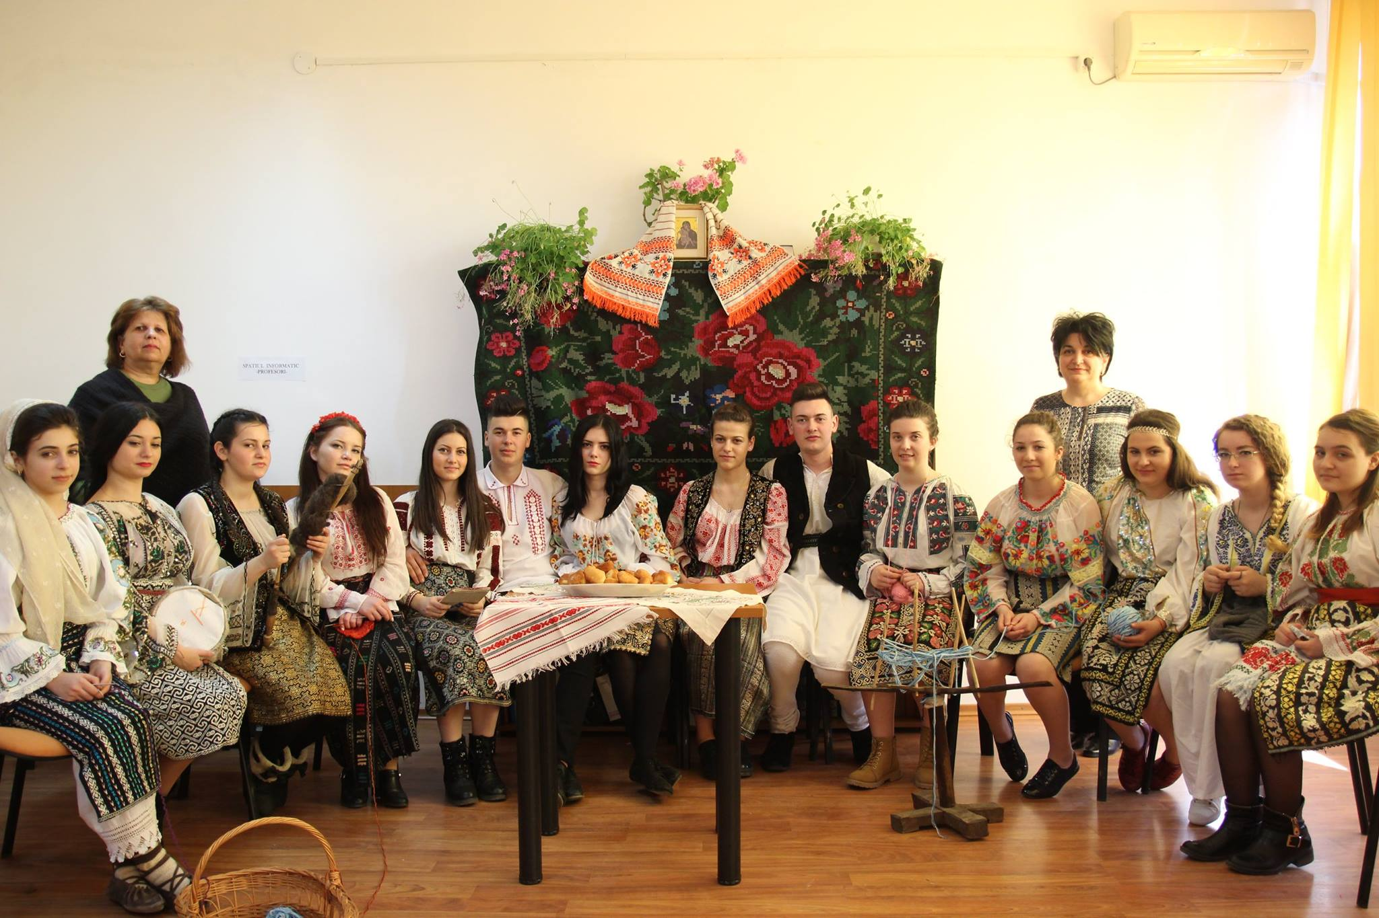

Slide 10
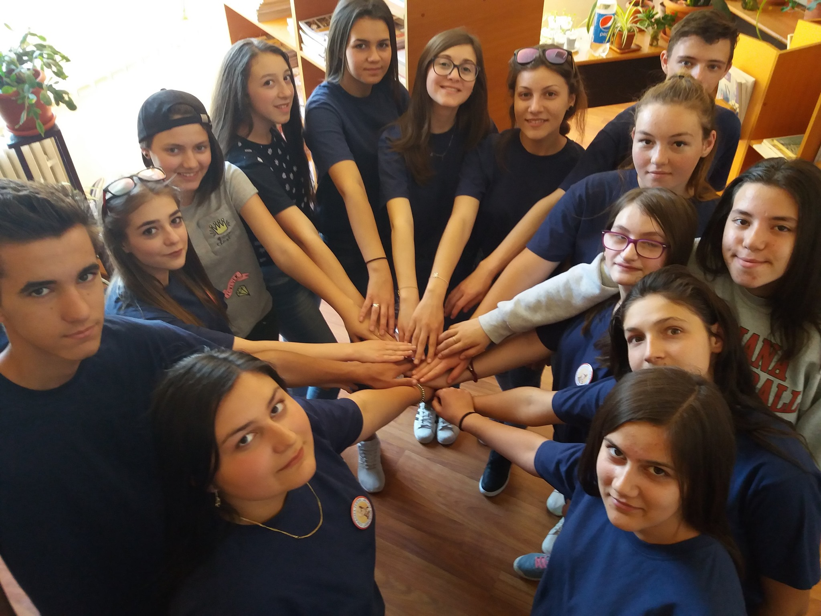

Slide 11
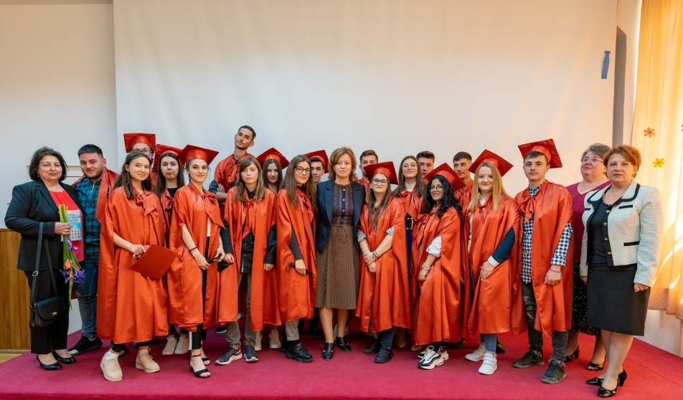
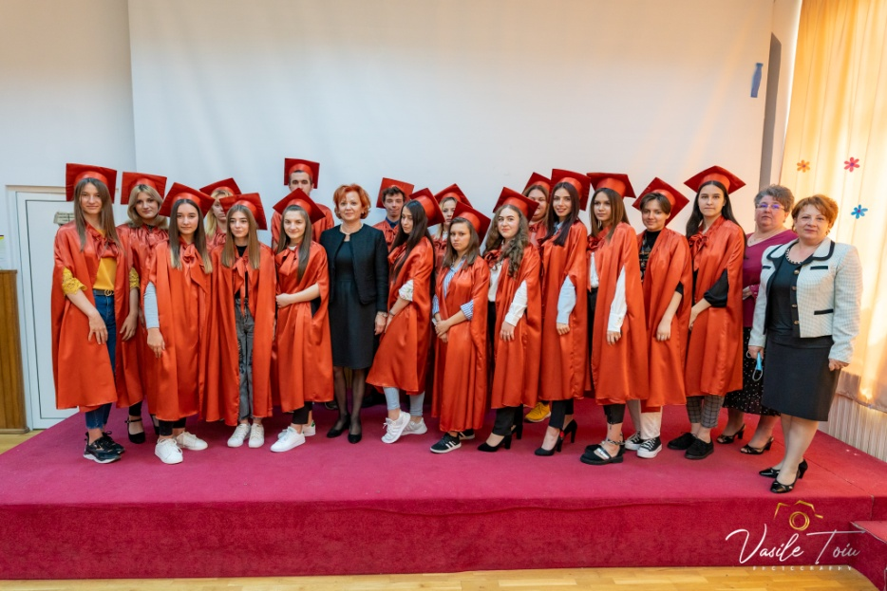
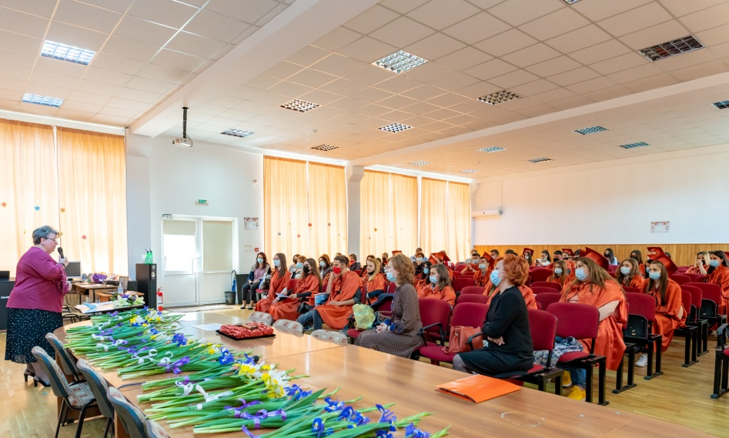
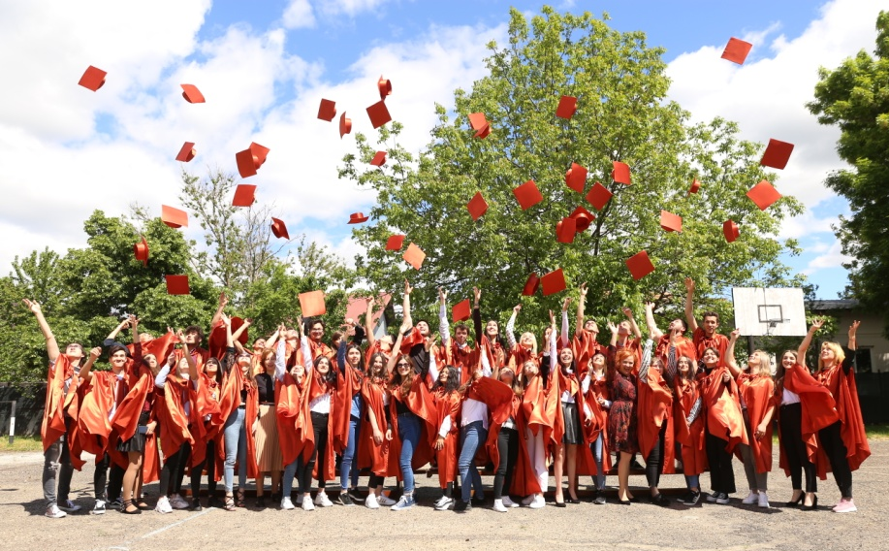
Asachi Graduation Day 2021

Slide 12

To meet the needs of internationalization in CTGA we implement the Erasmus+ KA1 project “ACCORD WE GROW TOGETHER” 2020-1-RO01-KA101-078593, 02.11.2020 - 30.04.2022
TOPICS OF THE PROJECT: competences in the field of Coaching, Stress / Conflict / Bullying Management, Inclusion Strategies, through Positive Education to combat absenteeism and school dropout.

Slide 13
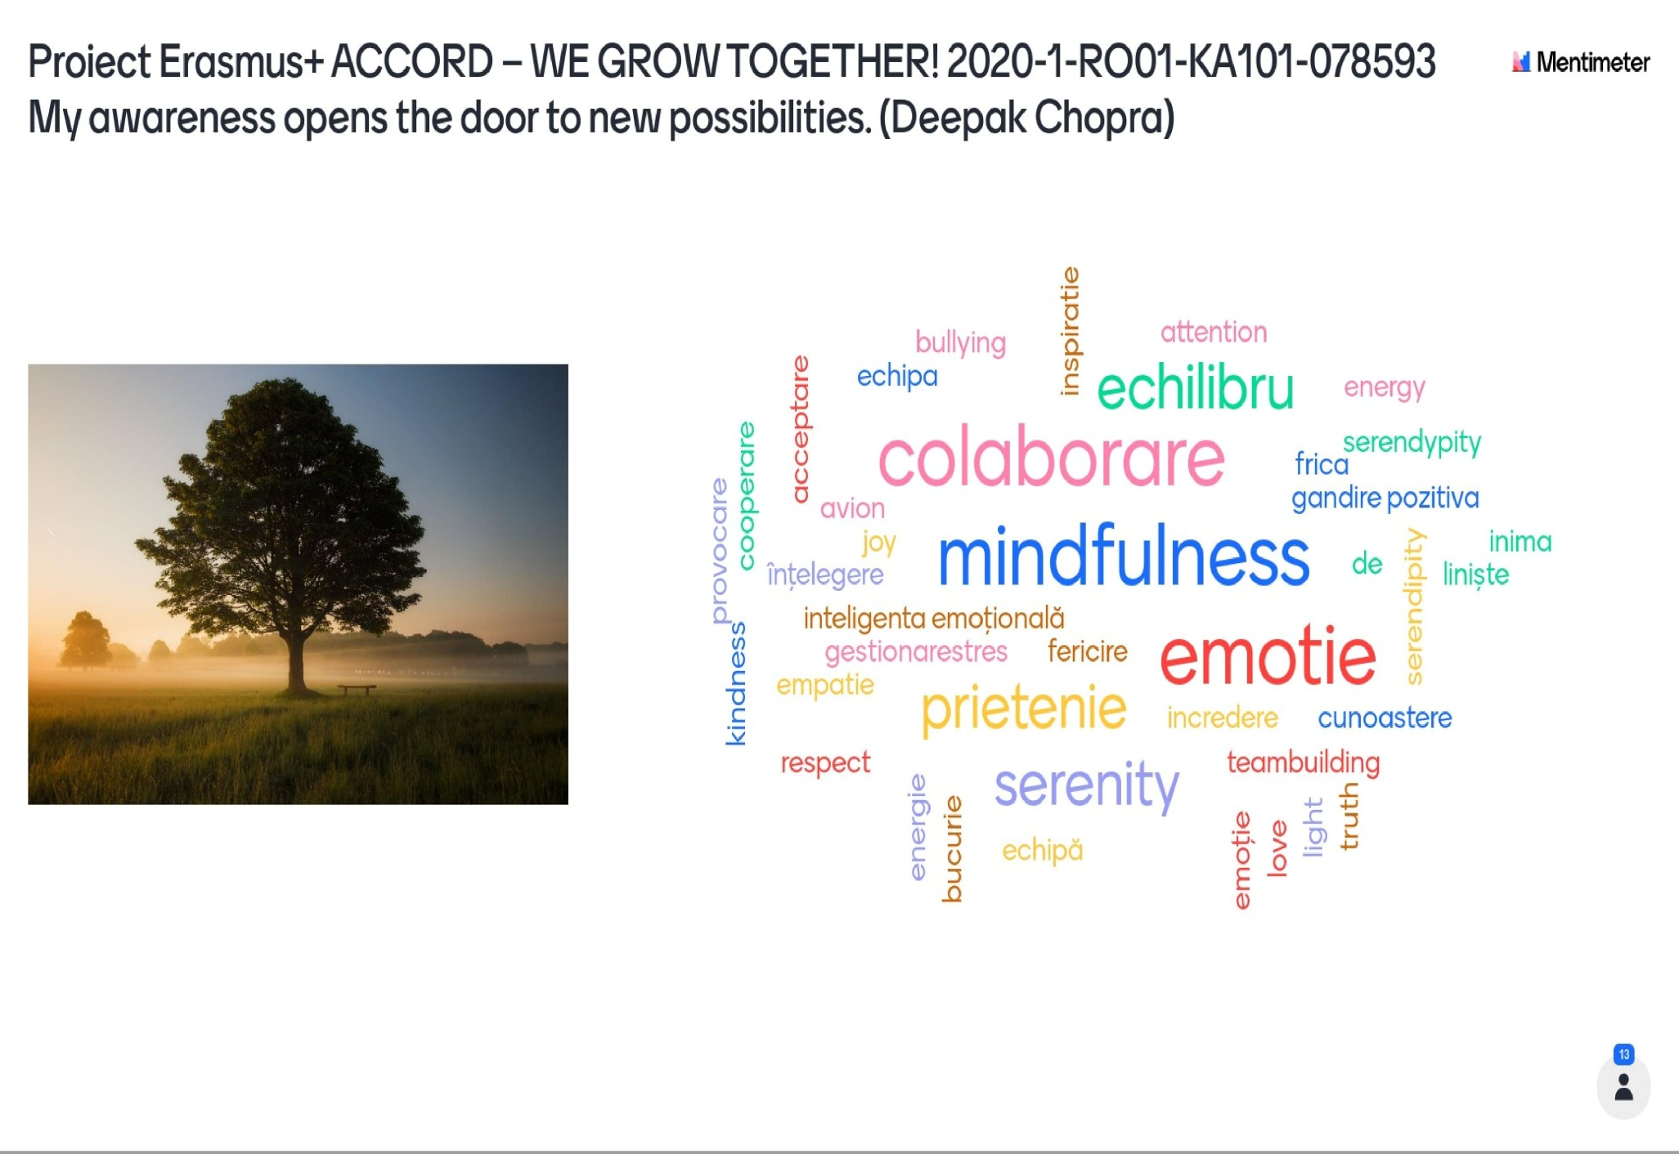

Slide 14
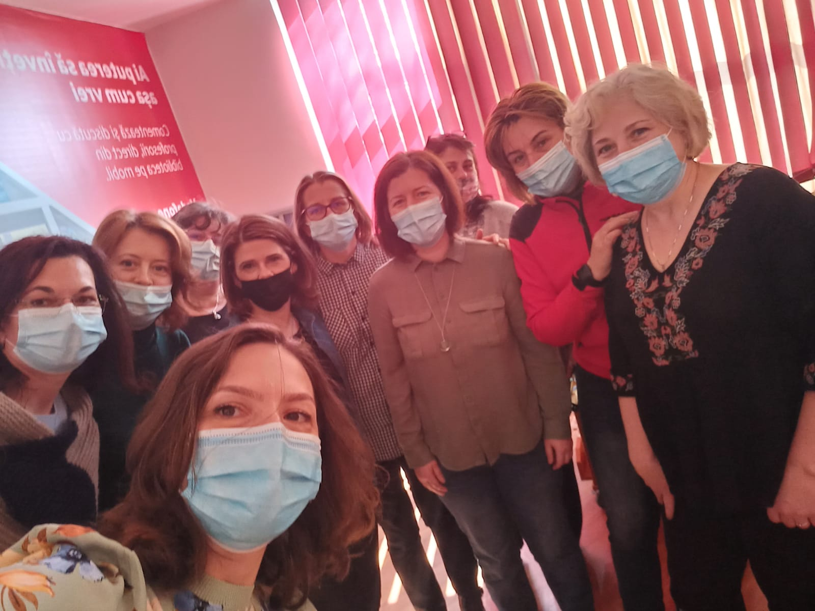
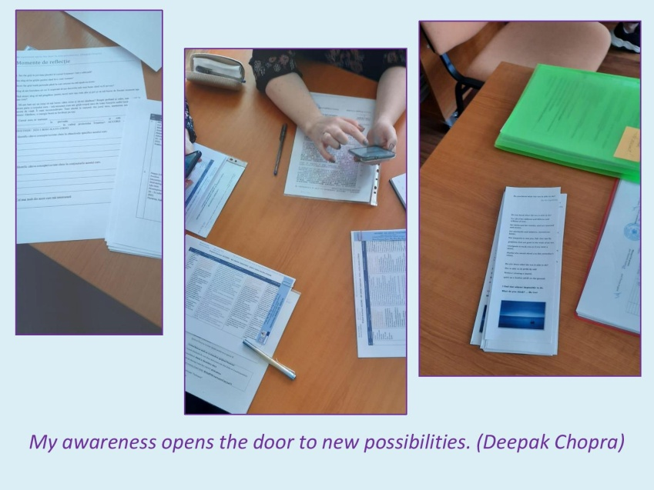
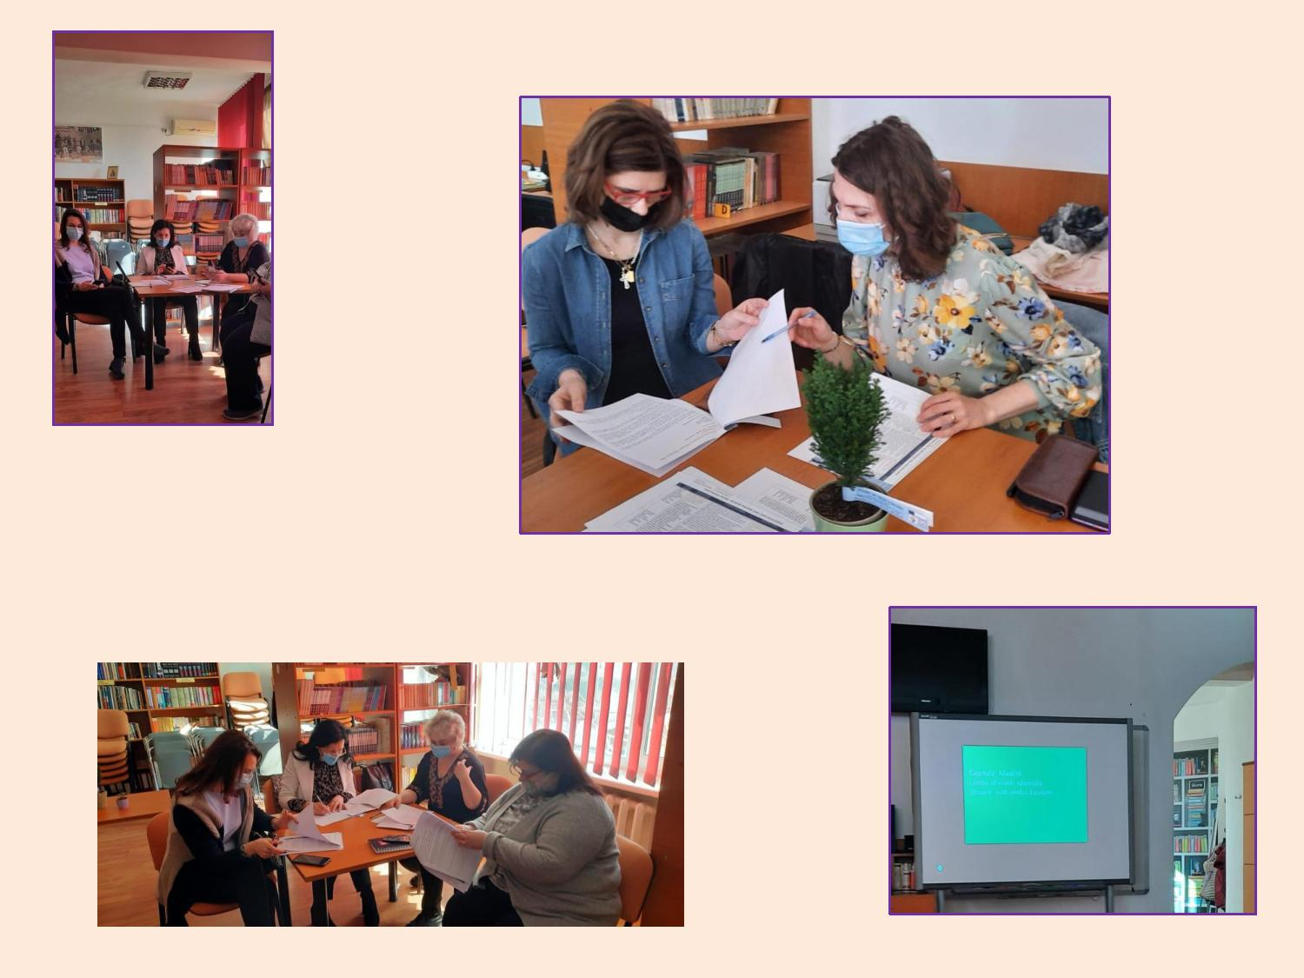
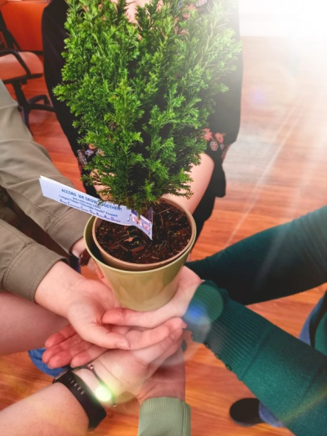

Slide 15


COLEGIUL TEHNIC “GHEORGHE ASACHI”
ACCORD WE GROW TOGETHER!
2020-1-RO01-KA101-078593
“Probably what teachers most want is to have their students’ sustained attention. But this itself is
hard to get unless the teacher is able to make the subject matter of the moment, whatever it is,
come alive, to make it compelling and relevant within a classroom atmosphere of safety, inclusion,
and belonging, along with a sense of learning as an adventure.
Paying attention is a trainable skill, capable of ongoing refinement. Attention and awareness
without distraction, in addition to simply balancing the power of thought and bringing a wiser
perspective to it, may give rise to an entirely different kind of thinking.
It may be that the future research will show that mindfulness training actually enhances creativity, freeing the mind to produce less routinized kinds of thoughts and freer and more imaginative associations.“
Jon Kabat Zinn, Mindfulness for beginners

Slide 16
ACCORD WE GROW TOGETHER!
2020-1-RO01-KA101-078593
PROJECT OBJECTIVES
O1. Development of stress management, conflict and bullying competences, in accordance with current psychopedagogy, in German and Spanish cultural educational spaces;
O2. Development of coaching and inclusion competences, in accordance with current psychopedagogy, in Italian and French cultural educational spaces;
O3. Developing soft skills for positive education, in accordance with current psycho-pedagogy, in Irish and Italian cultural educational spaces.
MOBILITIES: 12 teachers will participate in 6 structured courses; 2 teachers/course;
COURSE PROVIDERS:
Europass Teacher Academy - Florence Italy
PMS ERASMUS S.L.U. Alicante - Spain

Slide 17
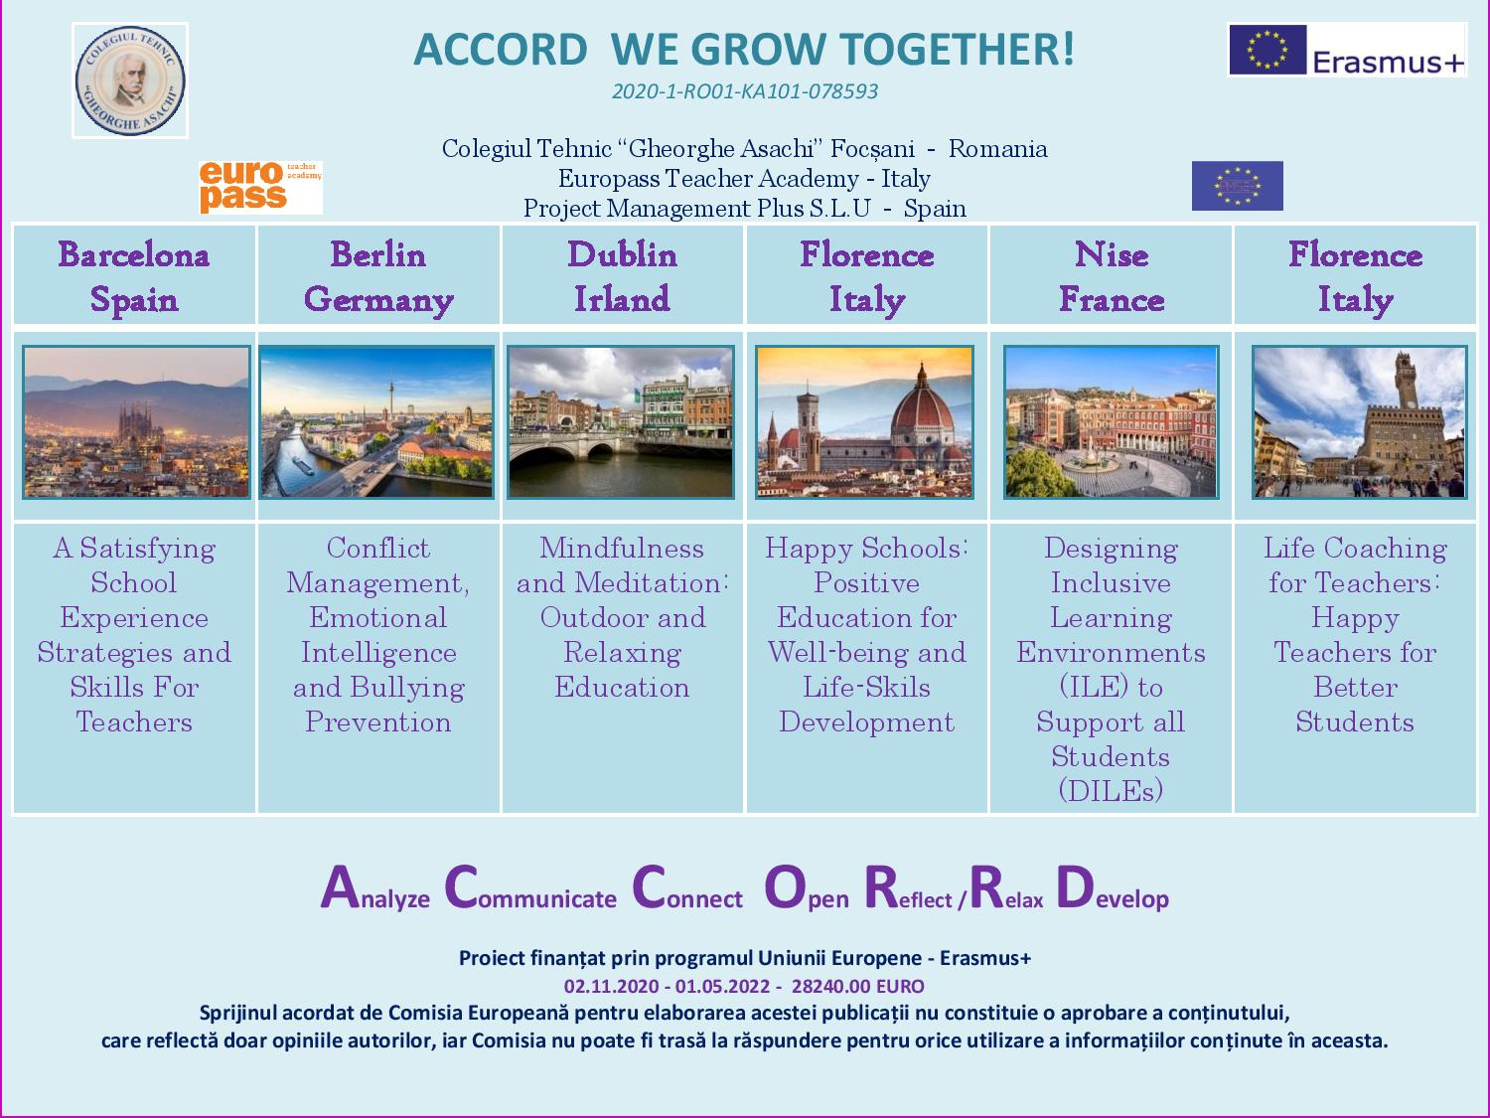

Slide 18
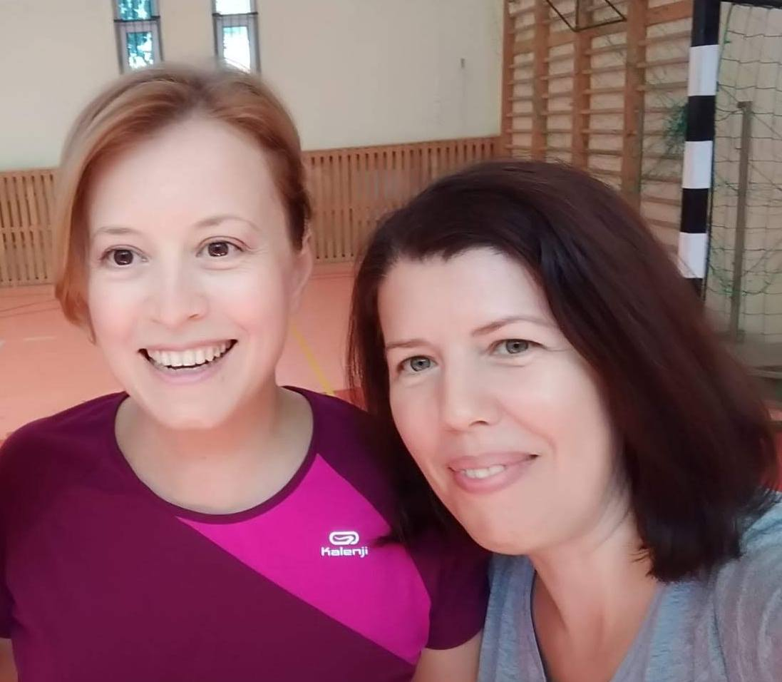
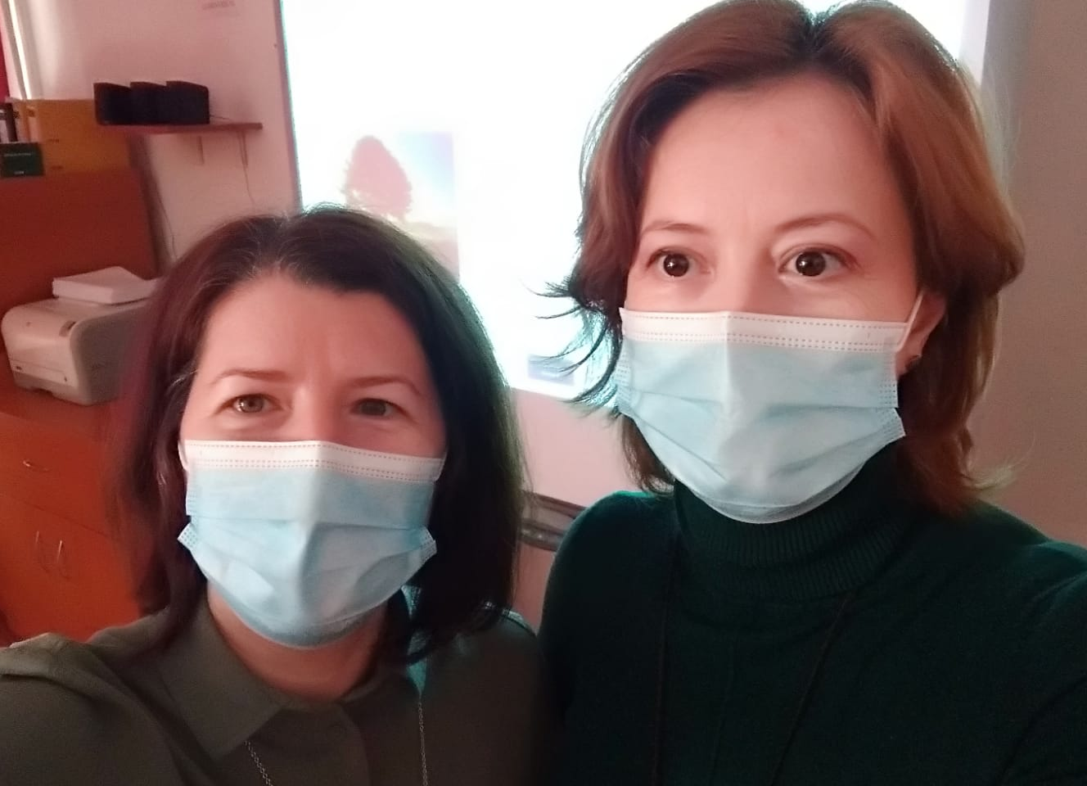
Marinela Anghel - Florina Anghele
English Language Teachers
Project Coordinators

Slide 19
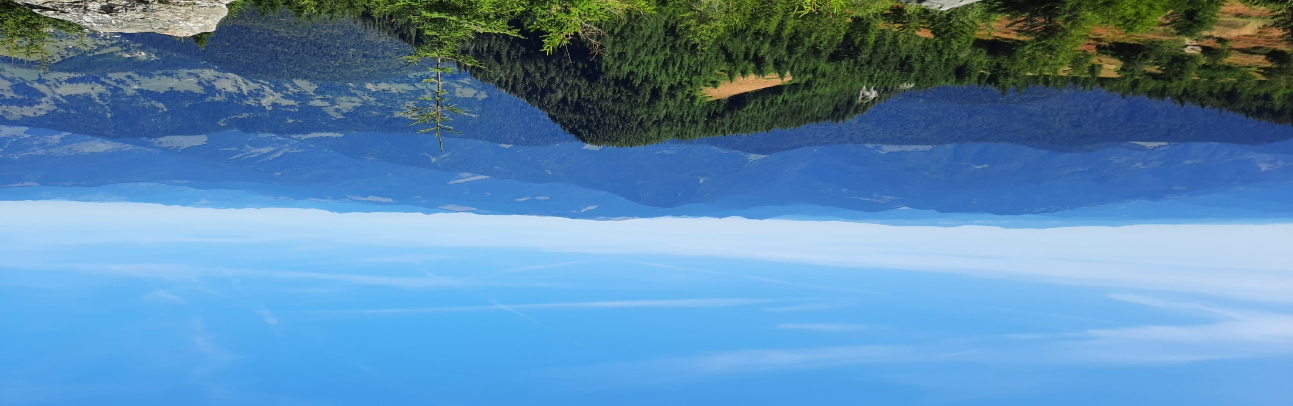

Marinela Anghel
  - English Language Teacher
- Reader: Kazuo Ishiguro, Haruki Murakami, John Fowles, Salman Rushdie, Vladimir Nabokov, Mircea Cărtărescu, Lucian Blaga, Daniel J. Siegel, Jon Kabat Zinn, Brené Brown, Antonio Machado, John O’ Donohue, Kabir
- Always interested in Writing: from poems as a therapy to Erasmus+ projects
- Tai Chi and Qi Gong Learner: Chris Pei, Shi Heng Yi, Dr. Paul Lam, Helen Liang
- Music listener: Queen, Maroon 5, Coldplay, Imagine Dragons, Pink, George Ezra, Haevn, Leonard Cohen, Chris Stapleton
- Newcomer in mindfulness and meditation
- Favourite quote: “Stay awkward, brave and kind.”, Brene Brown
  - Motto: “May all human beings walk in beauty.”, Navajo Prayer

Slide 20
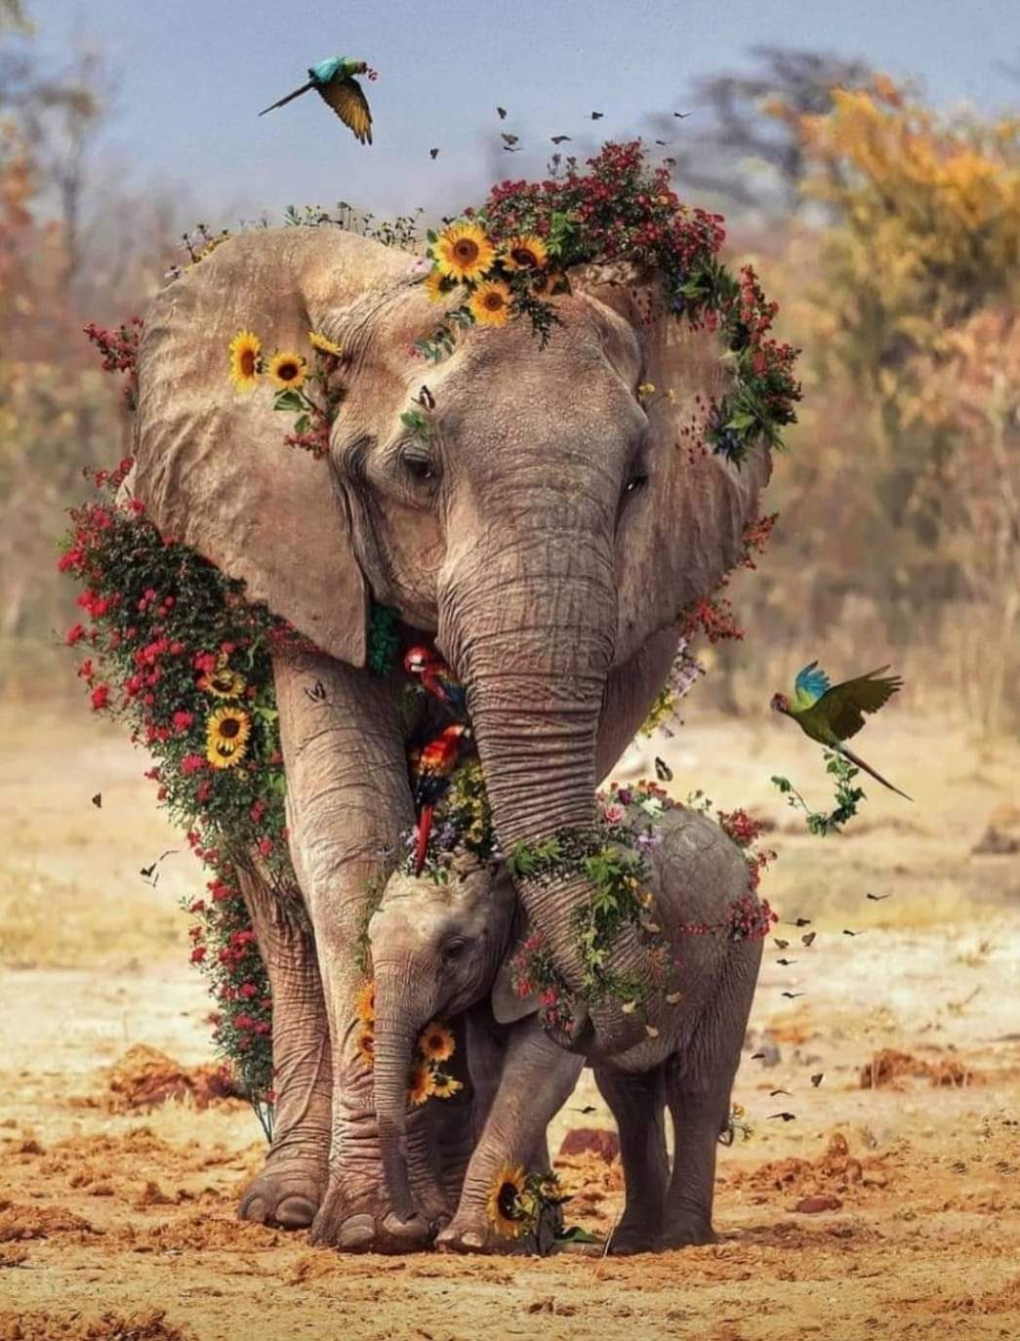
Florina Anghele
English Language Teacher
A triggering book: Breaking the Habit of Being Yourself: How to Lose Your Mind and Create a New One, Joe Dispenza
Latest interests: mindfulness, neuroscience, reconnecting, parenting
A singer: Asaf Avidan (The Labyrinth Song)
Newcomer in mindfulness and meditation
Favourite quote: We may not be responsible for the world that created our minds, but we can take responsibility for the mind with which we create our world. Gabor Mate
Motto: Where attention goes, neural firing flows, and neural connection grows. Daniel J. Siegel

Slide 21
For more information about our college and about our Erasmus projects visit the following links:
- College website - http://ctasachifocsani.ro/
- Erasmus+ Project websites:
http://ctasachifocsani.ro/proiect/
http://ctasachifocsani.ro/proiect/noutati/
- College Facebook Page:
https://www.facebook.com/cdi.colegiultehnicgheorgheasachi
- Erasmus+ Projects Facebook page:
https://www.facebook.com/ctasachifocsani.ro
- Contact:
Marinela Anghel – English Language Teacher; Erasmus+ Project Manager
marinelaanghel2004@yahoo.com marinelaanghel2012@gmail.com
Florina Anghele – English Language Teacher; Erasmus+ Project Manager floridamian@yahoo.com
Analyze Communicate Connect Open Reflect /Relax Develop
we grow together

